Slide 1
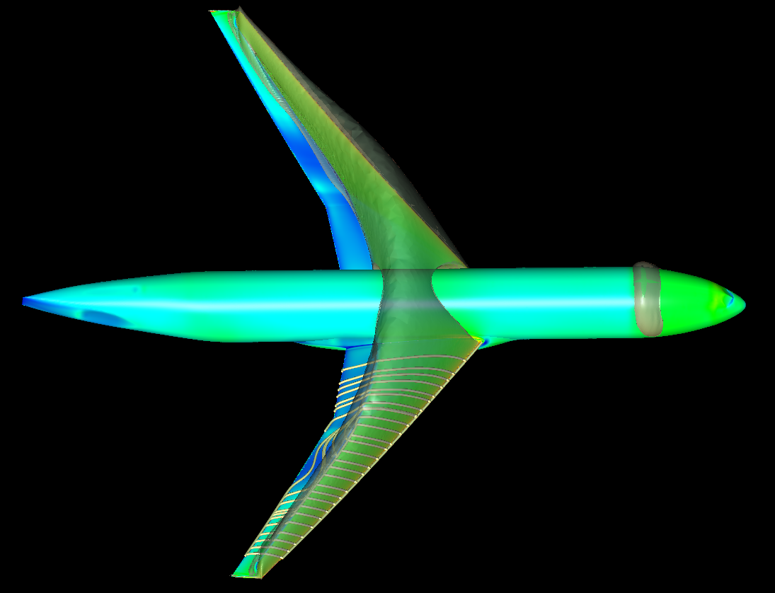
7th AIAA Drag Prediction Workshop Metacomp Technologies, Inc.
Nili Bachchan
Paul Batten
Ravi Kovvali
Oshin Peroomian
Amar Potturi
Beerinder Singh
AIAA Aviation 2022
Chicago, IL 25-26 June 2022

Slide 2
Overview
Solver, settings & models
Case 1a: Grid Convergence Study
Case 2a: Alpha Sweep (Re=20M)
Case 3: Re sweep (C_{L}=0.50)
Case 6: Coupled aero-structural
Summary

Slide 3
Solver & Settings
CFD++ Version 20.1
Bounded nodal-reconstruction transport
HLLC Riemann solver
Self-tuning far-field absorbing layers
Implicit solver with algebraic multi-grid acceleration
C_{L}-driver option (for imposed C_{L} cases)
SARC+QCR2013 and SST models

Slide 4
Case 1a: Grid Convergence Study
6 Simulations performed – one with each grid from the JAXA hybrid mesh family: tiny, coarse, medium, fine, extra fine and ultra fine
CFD++’s C_{L}-driver used to automatically adjust the angle-of-attack to achieve desired C_{L} = 0.58 (± 0.0001)

Slide 5
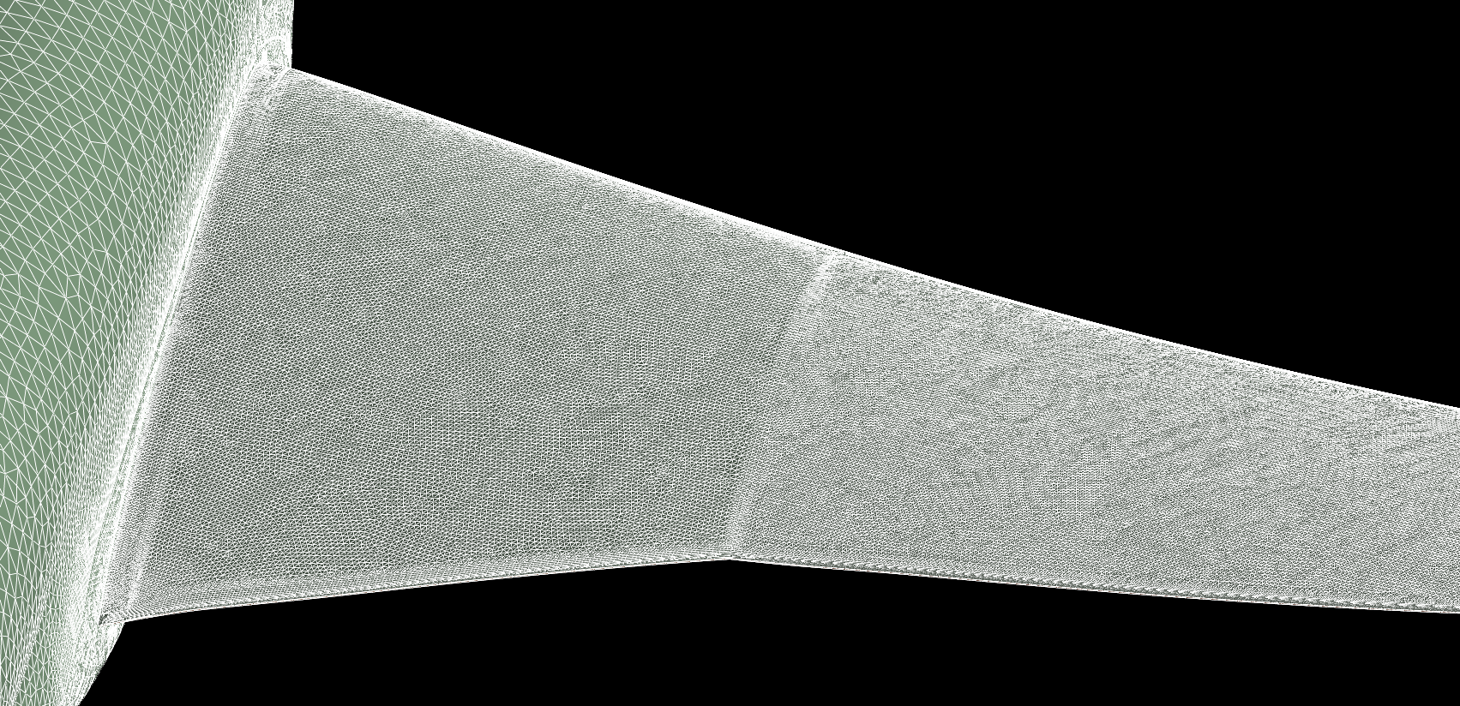
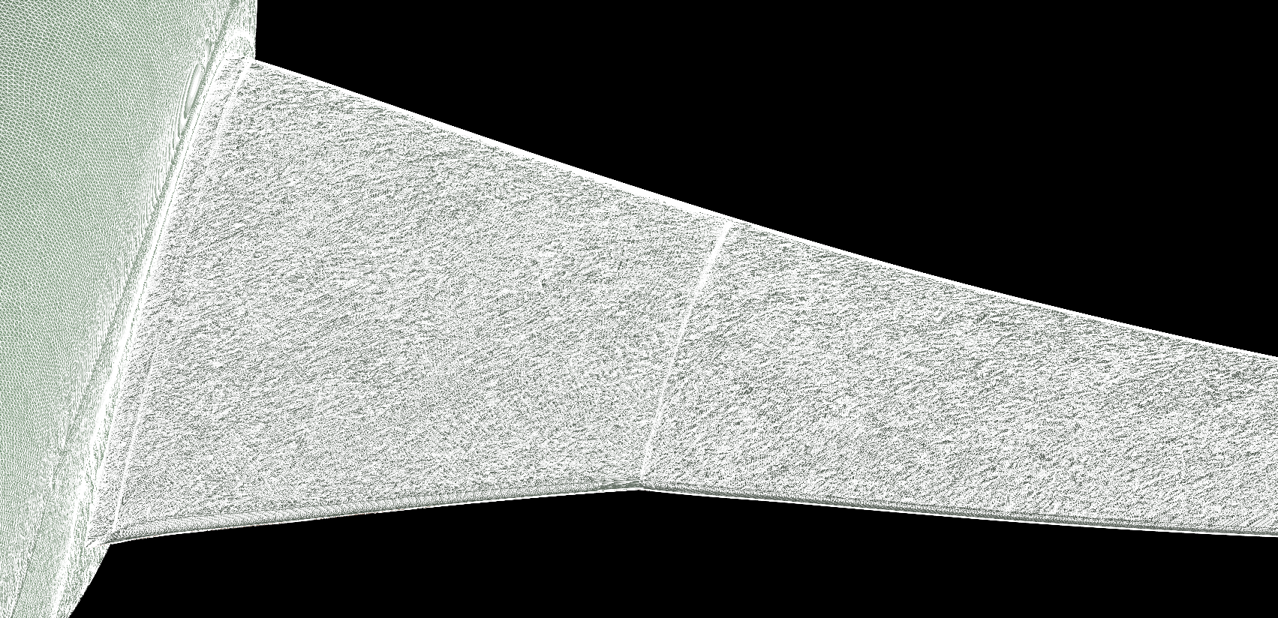
Grids
JAXA hybrid mesh family with tetrahedrals, pyramids, prisms, and hexahedrals
Grid Level | # Cells
Tiny | 25,294,690
Coarse | 76,058,884
Medium | 164,065,758
Fine | 295,240,476
Extra fine | 476,358,610
Ultra fine | 739,171,907

Slide 6
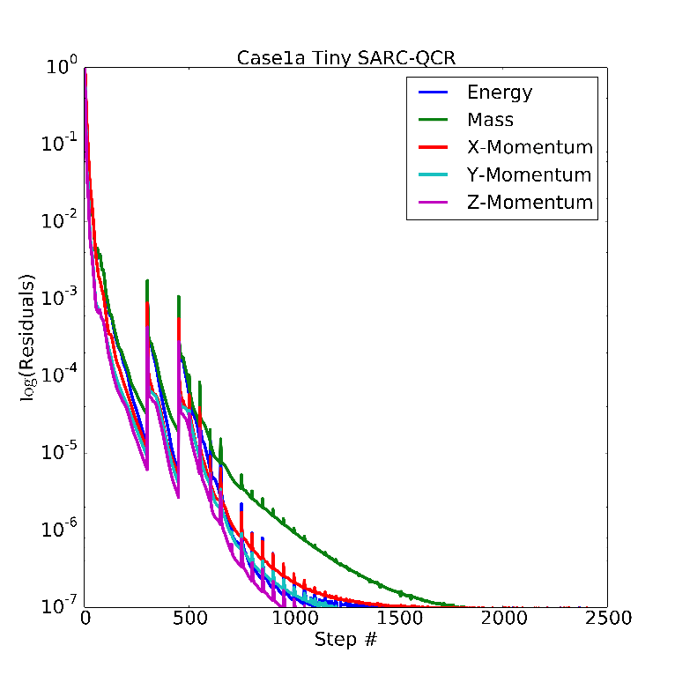
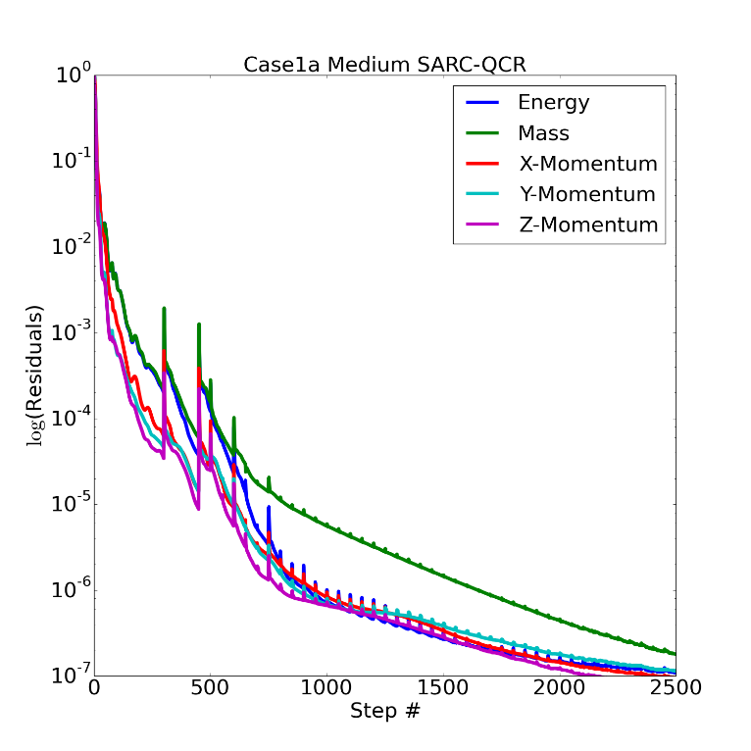
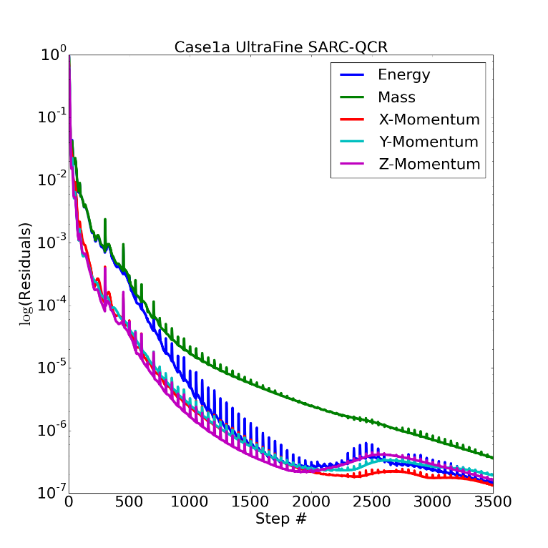
Sample Residual Convergence
Tiny
Medium
Ultra Fine

Slide 7
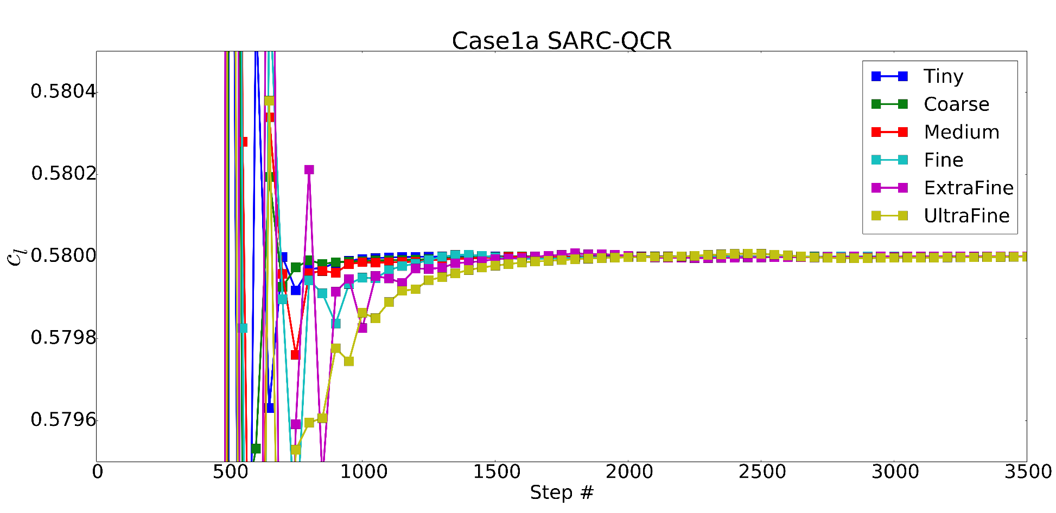
C_{L} History

Slide 8
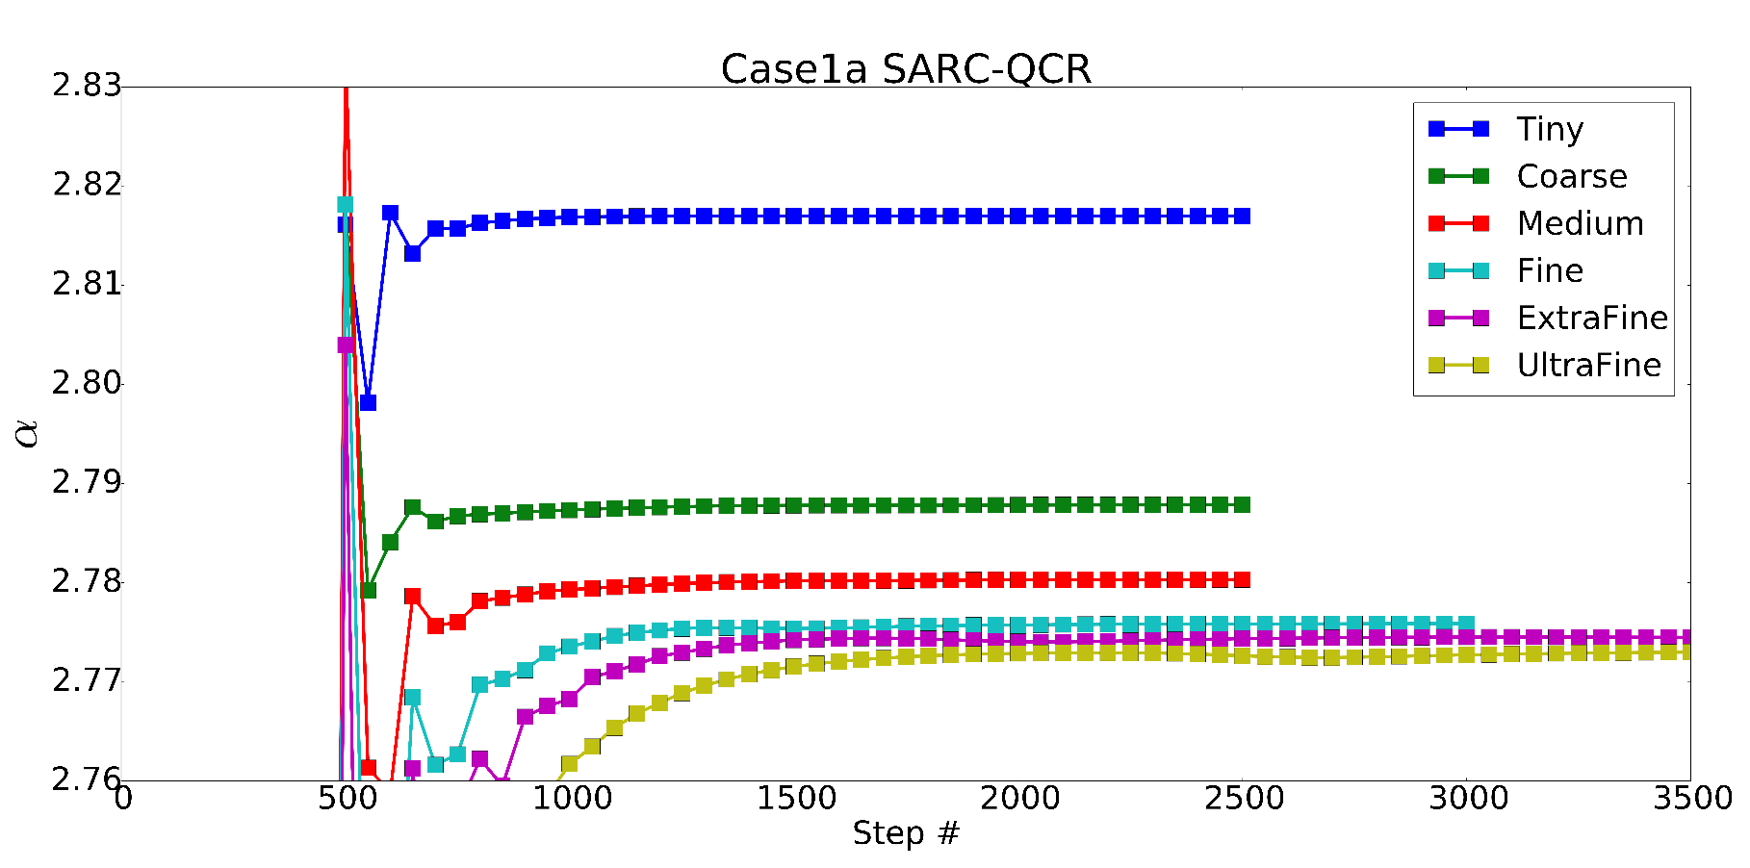
α History

Slide 9
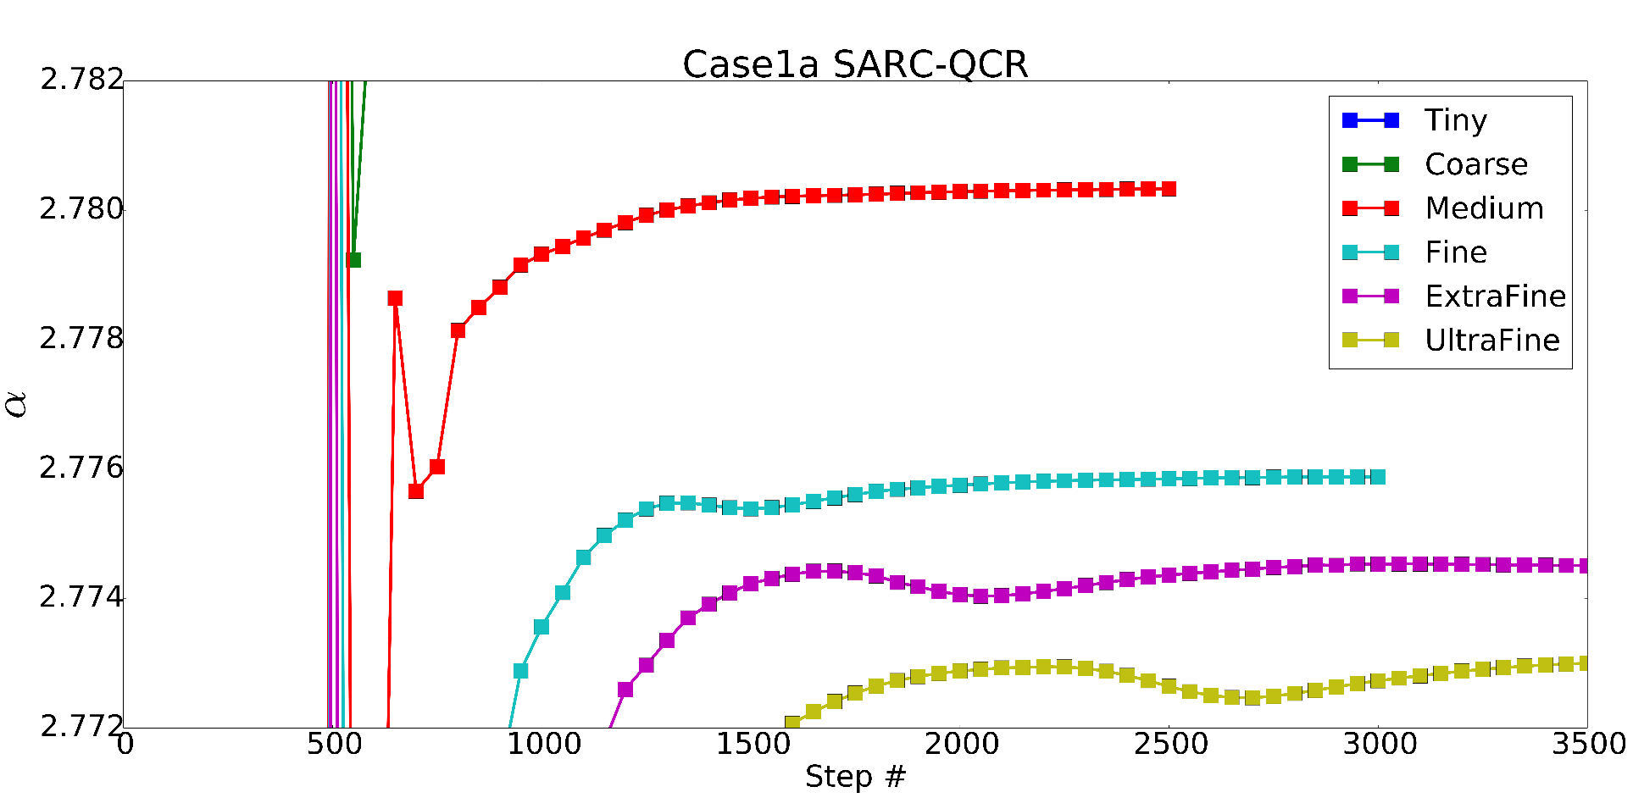
α History (Zoomed-in)

Slide 10
Grid Convergence

Slide 11
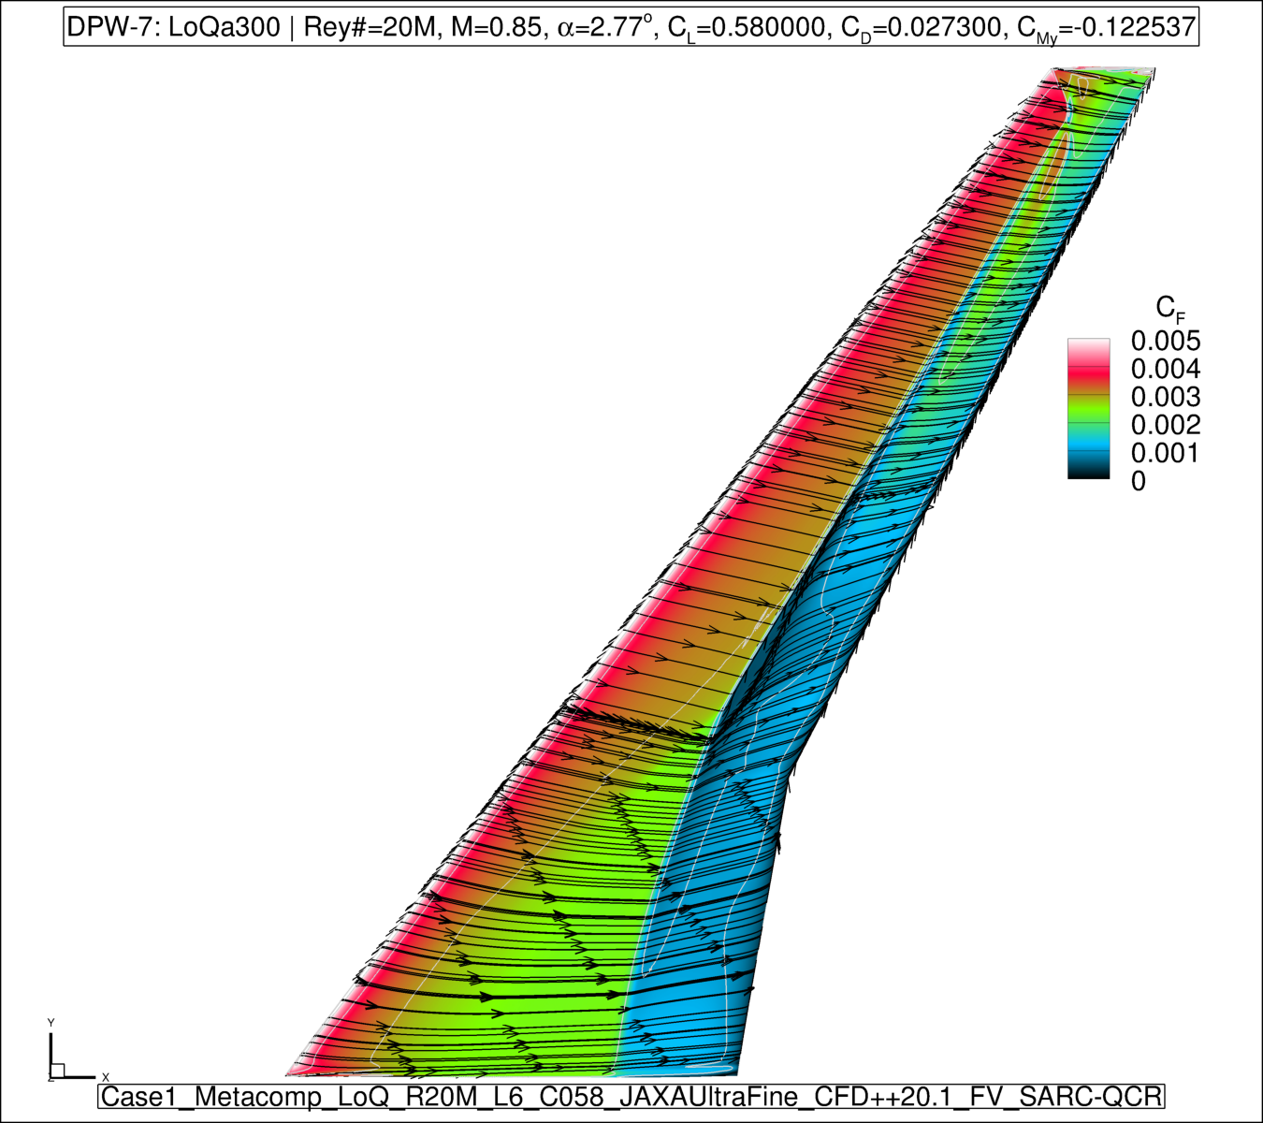
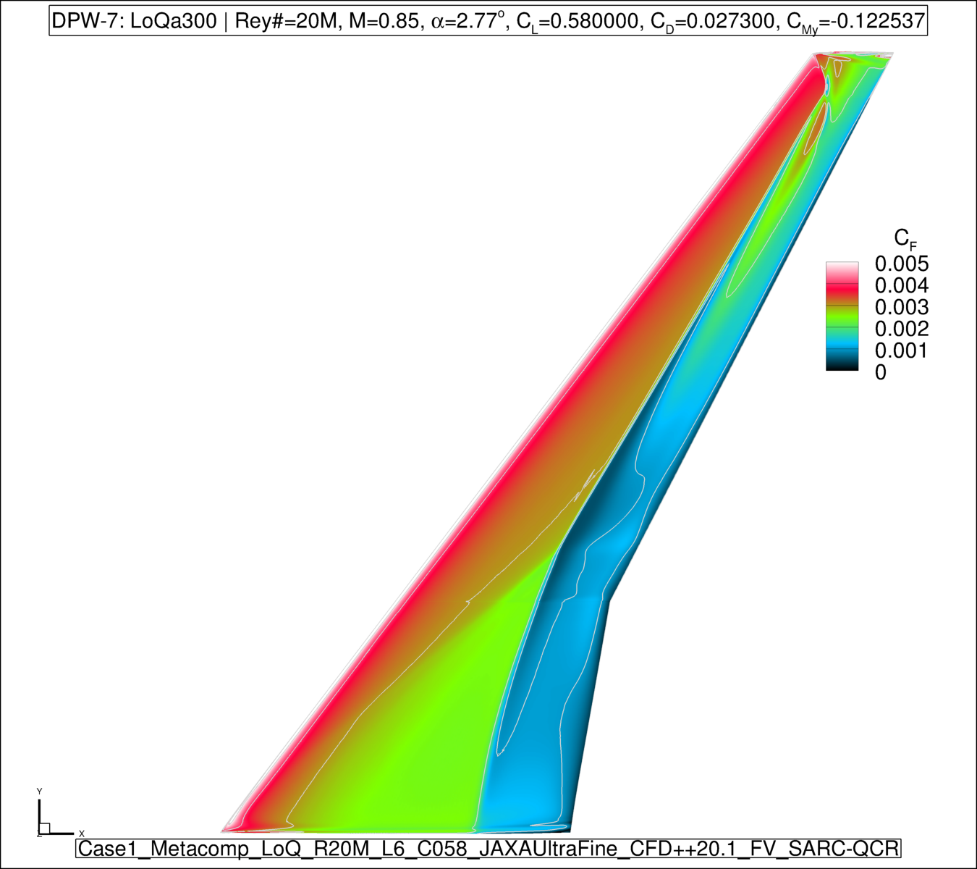
Case 2a : Wing-Body Alpha Sweep
α=2.75˚Cl =0.580000 SARC-QCR

Slide 12
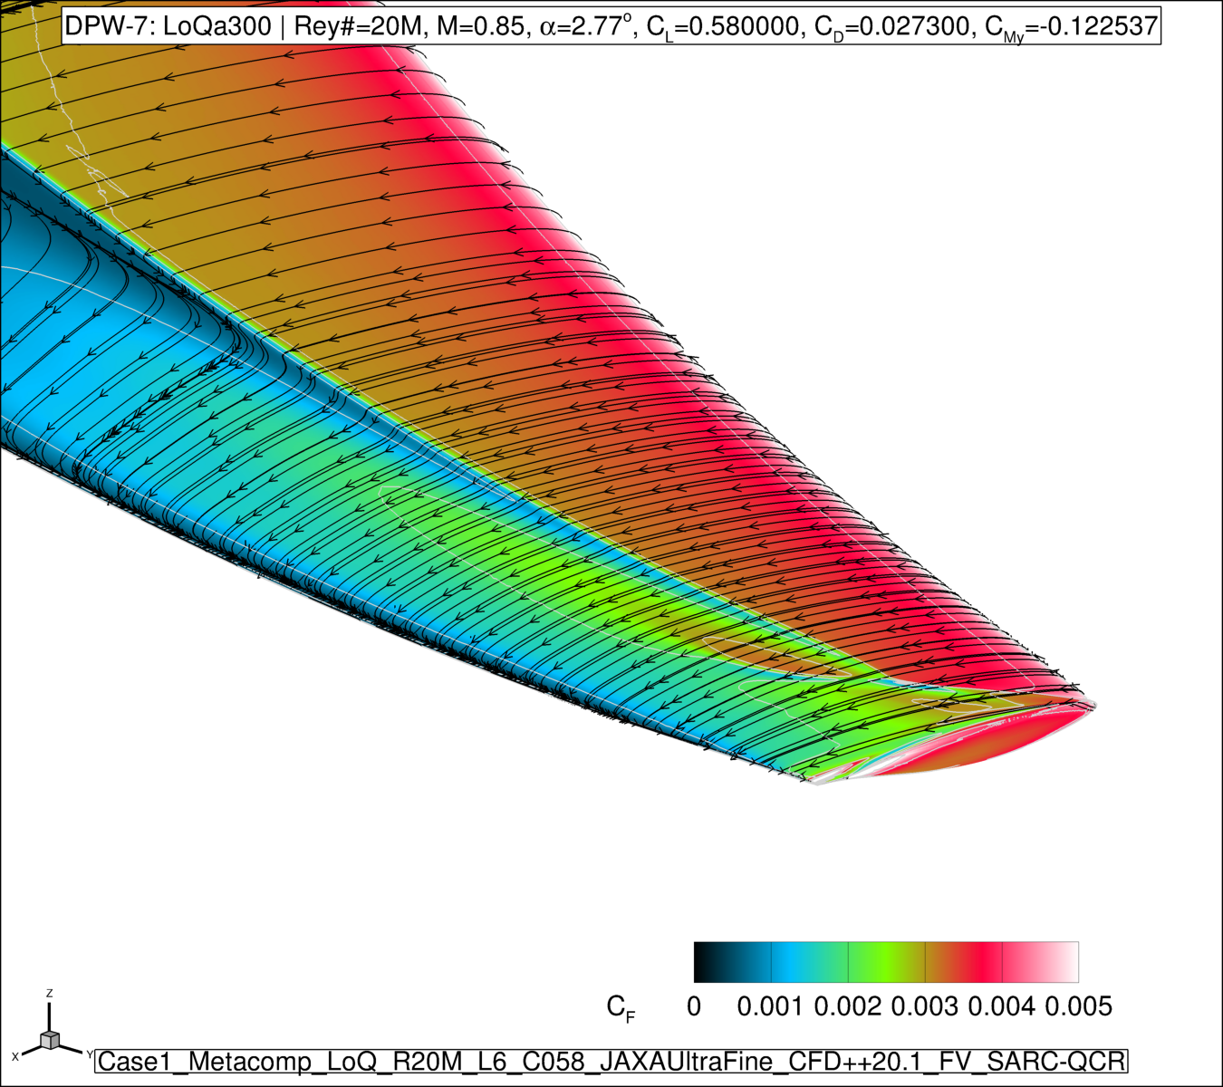
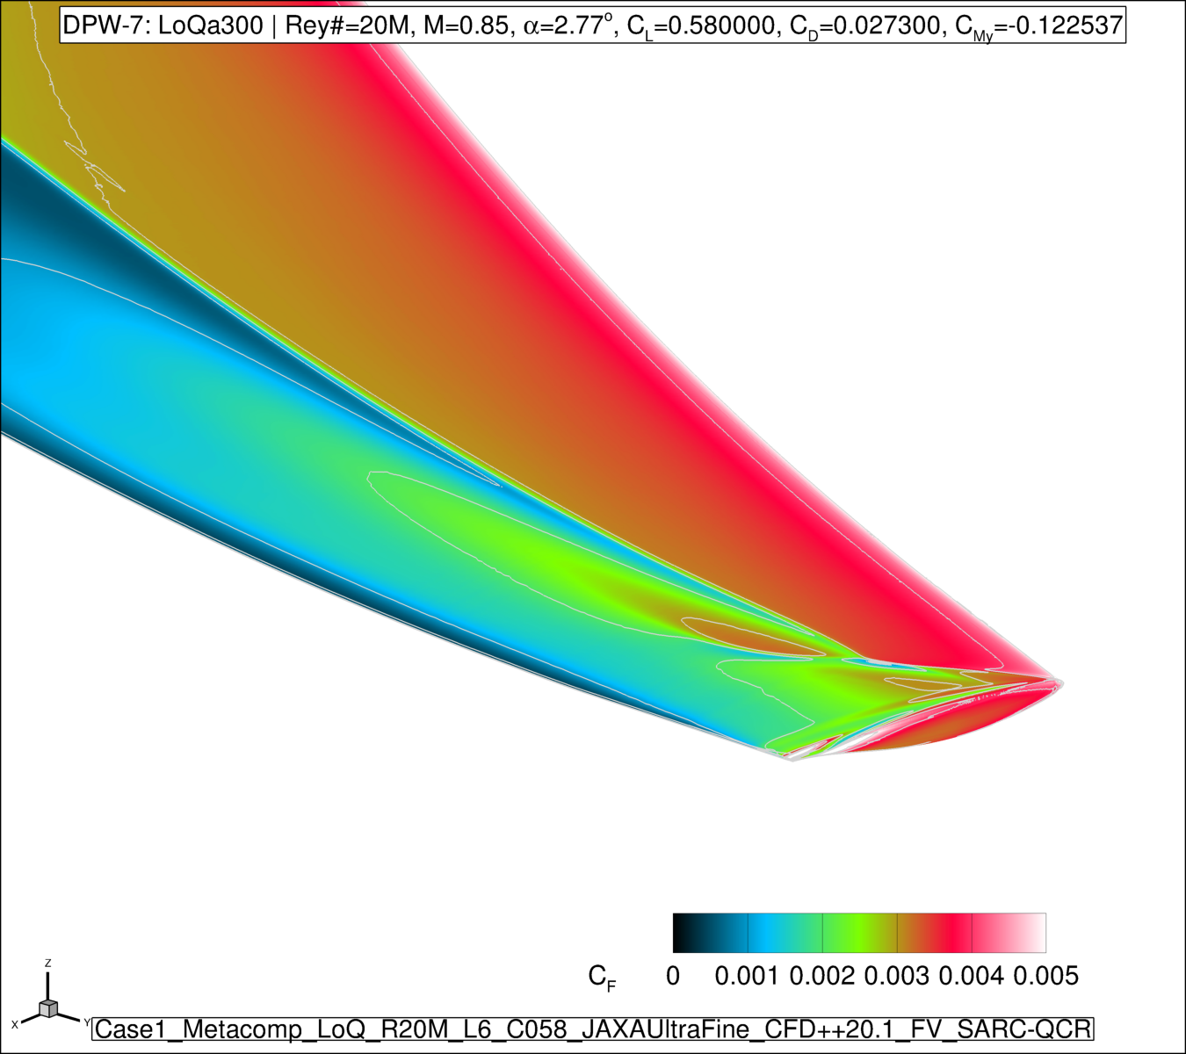
Case 2a : Wing-Body Alpha Sweep
α=2.75˚Cl =0.580000 SARC-QCR

Slide 13
Case 2a : Wing-Body Alpha Sweep
Flow conditions: Mach 0.85, Re=20M, T_{total}= -250˚F
CFD++ Compressible RANS (Air, Perfect Gas)
α | Mesh
2.23˚ (C_{L}=0.50) | 2.50˚ LoQ JAXA Medium
2.75˚ | 2.75˚ LoQ JAXA Medium
3.00˚ | 3.00˚ LoQ JAXA Medium
3.25˚ | 3.25˚ LoQ JAXA Medium
3.50˚ | 3.50˚ LoQ JAXA Medium
3.75˚ | 3.75˚ LoQ JAXA Medium
4.00˚ | 4.00˚ LoQ JAXA Medium
4.25˚ | 4.25˚ LoQ JAXA Medium

Slide 14
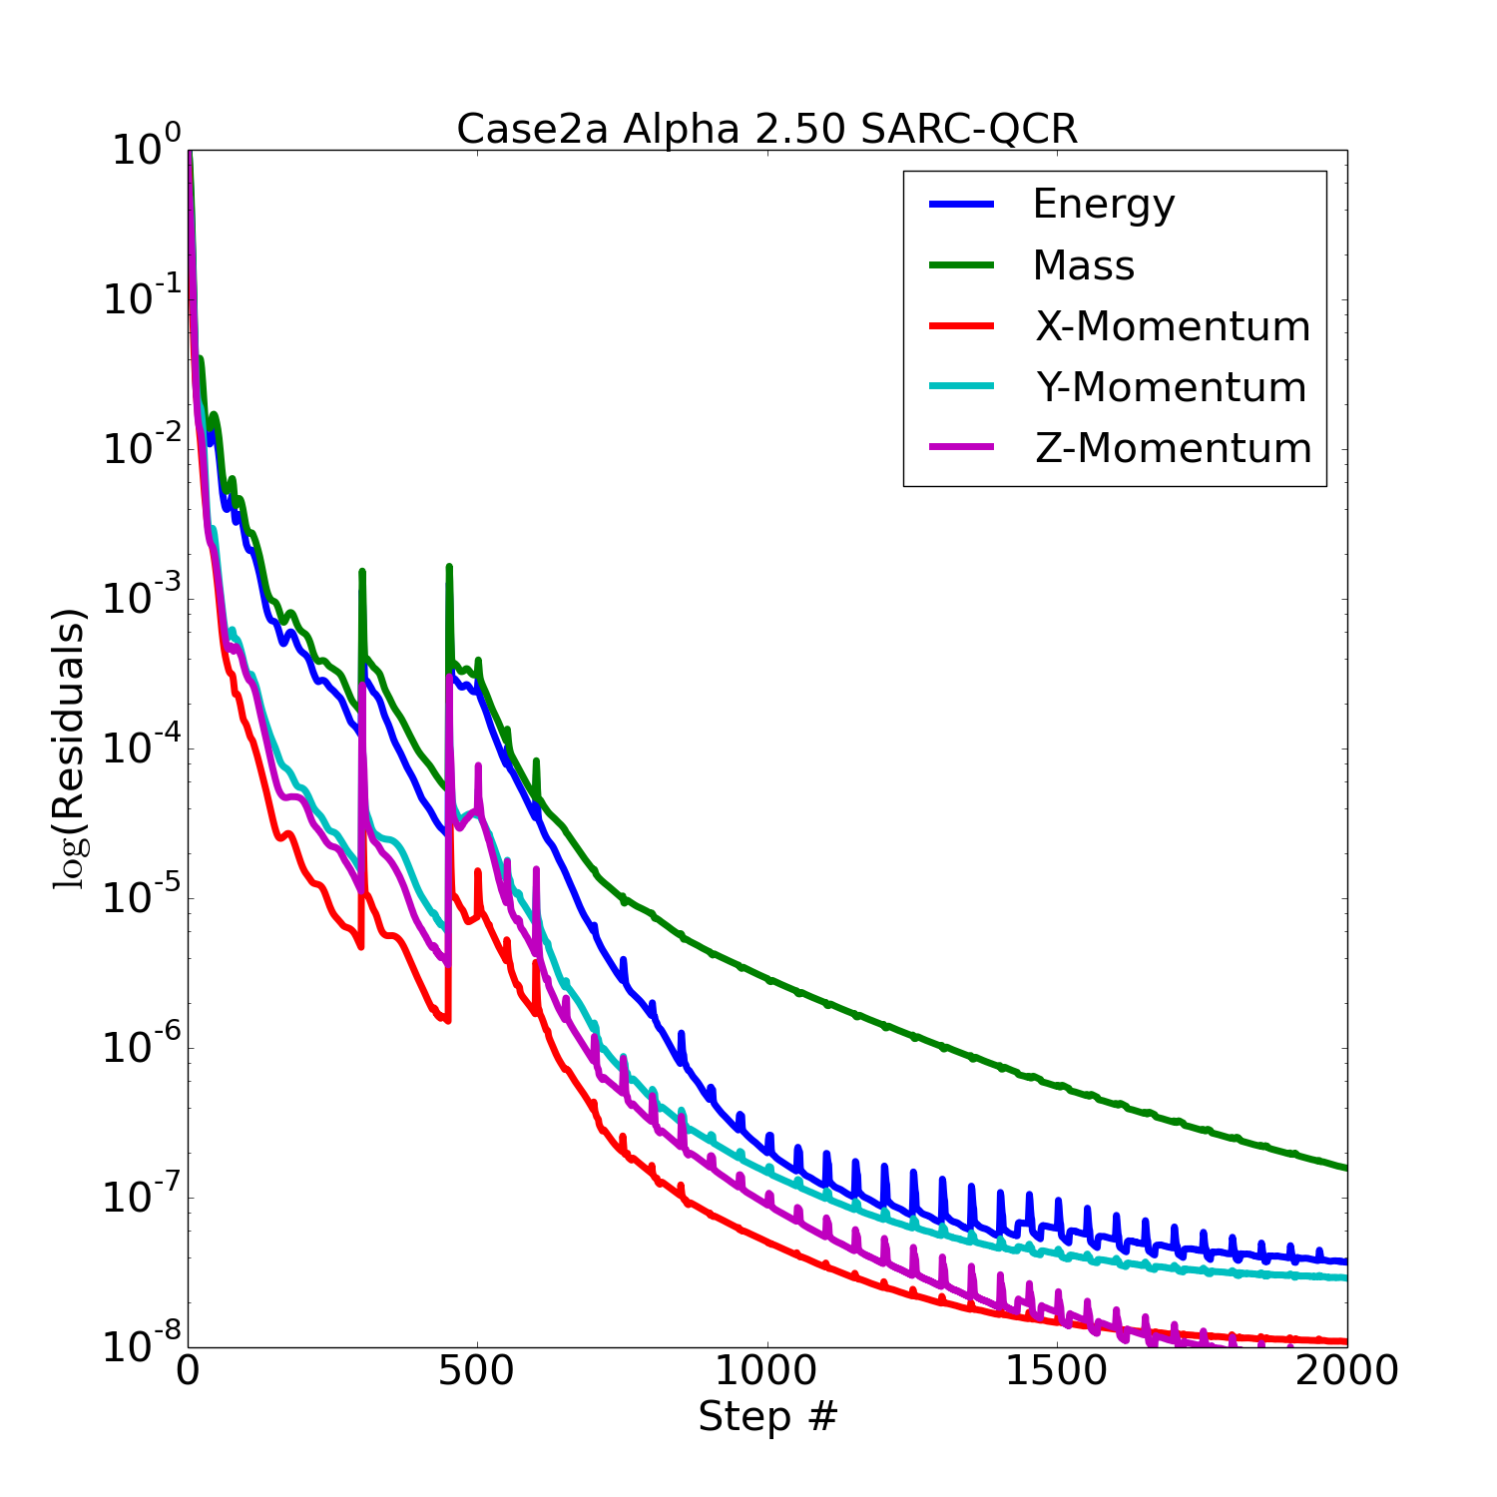
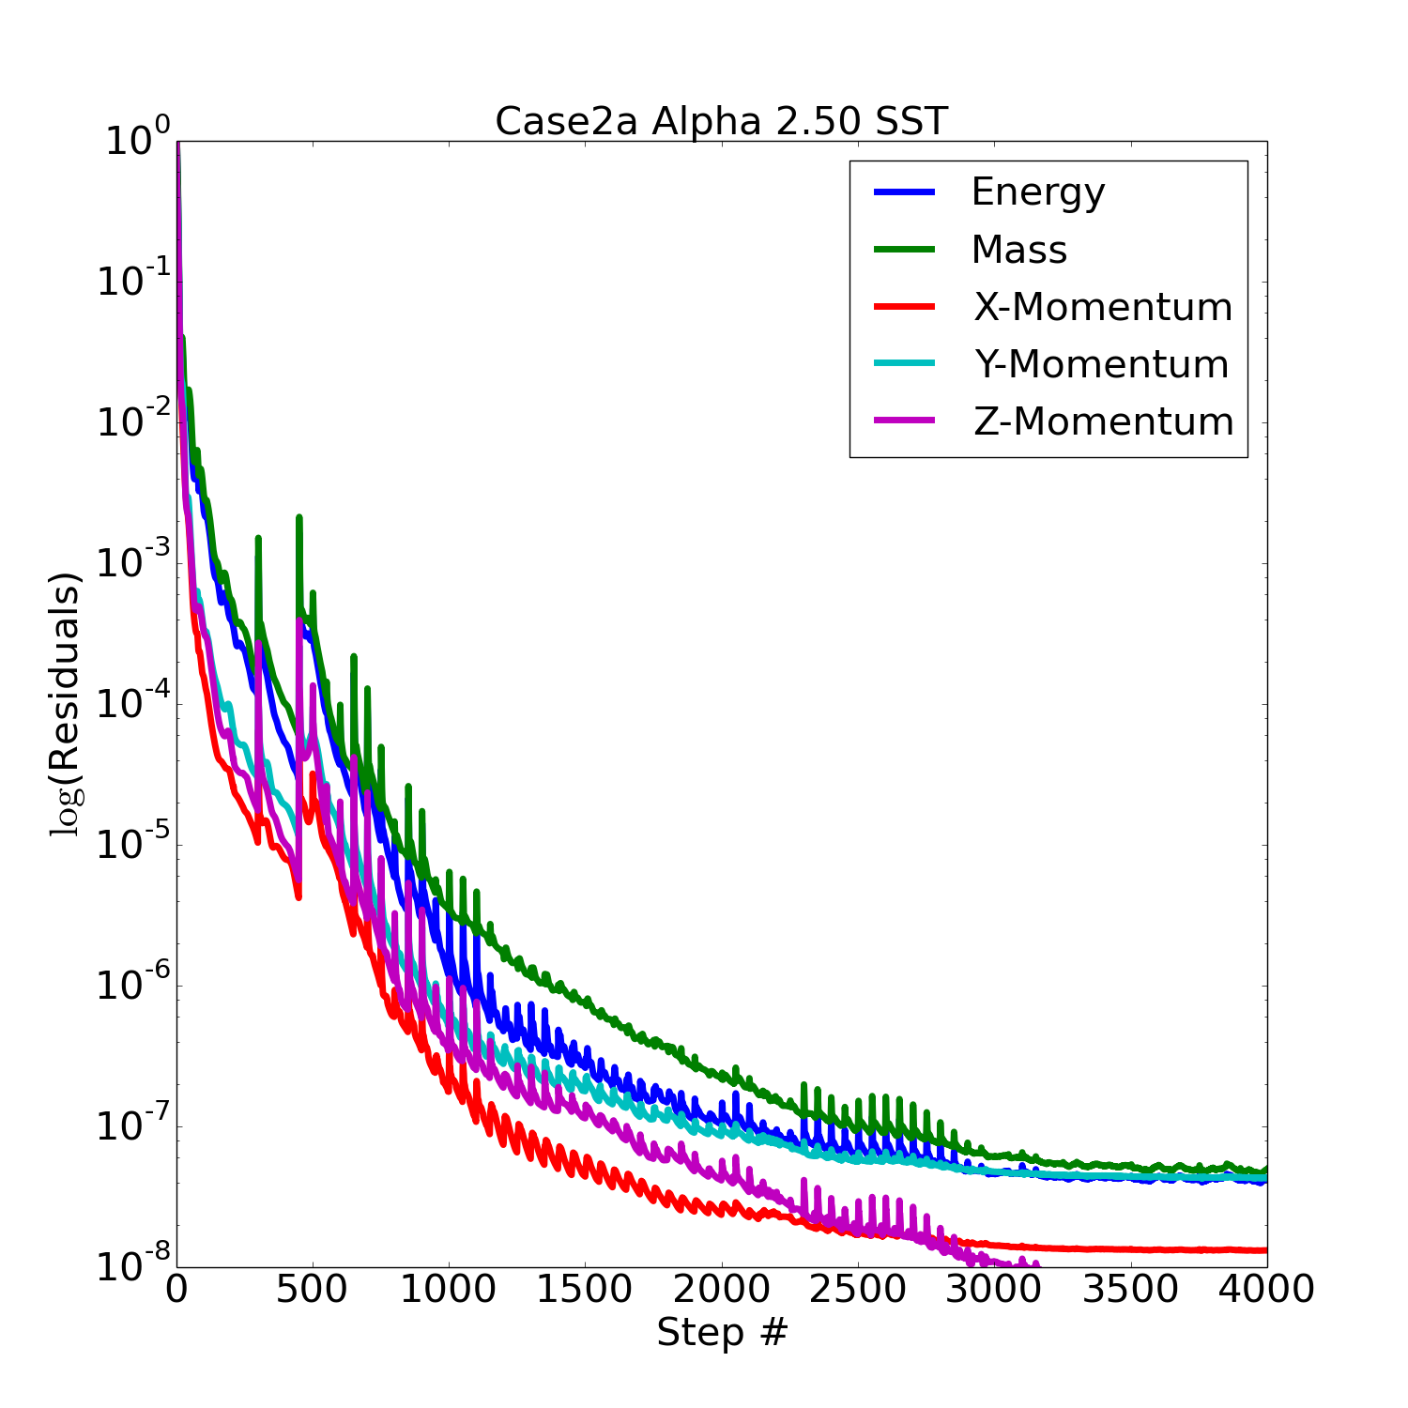
Residuals: α = 2.50˚ (C_{L}-driver active)
Notes:
OLD

Slide 15
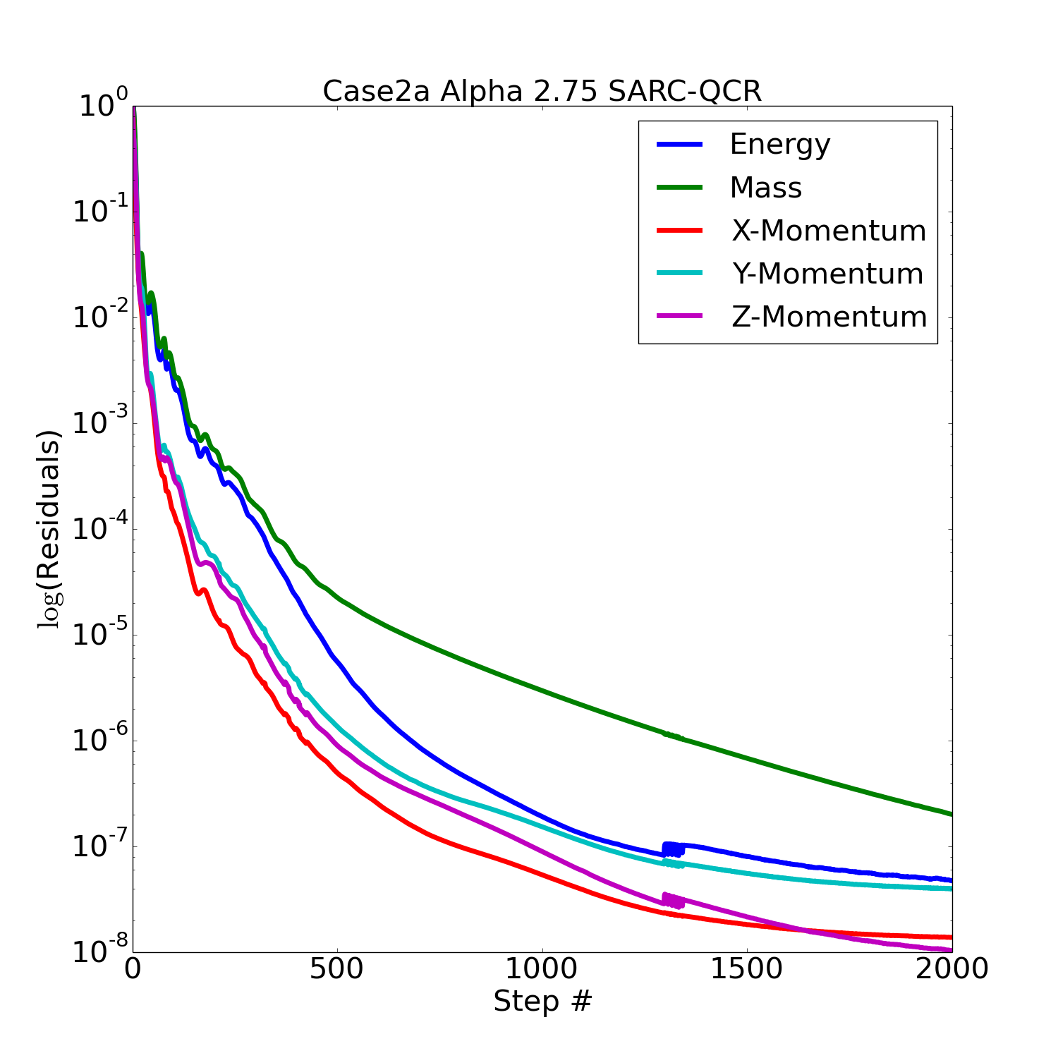

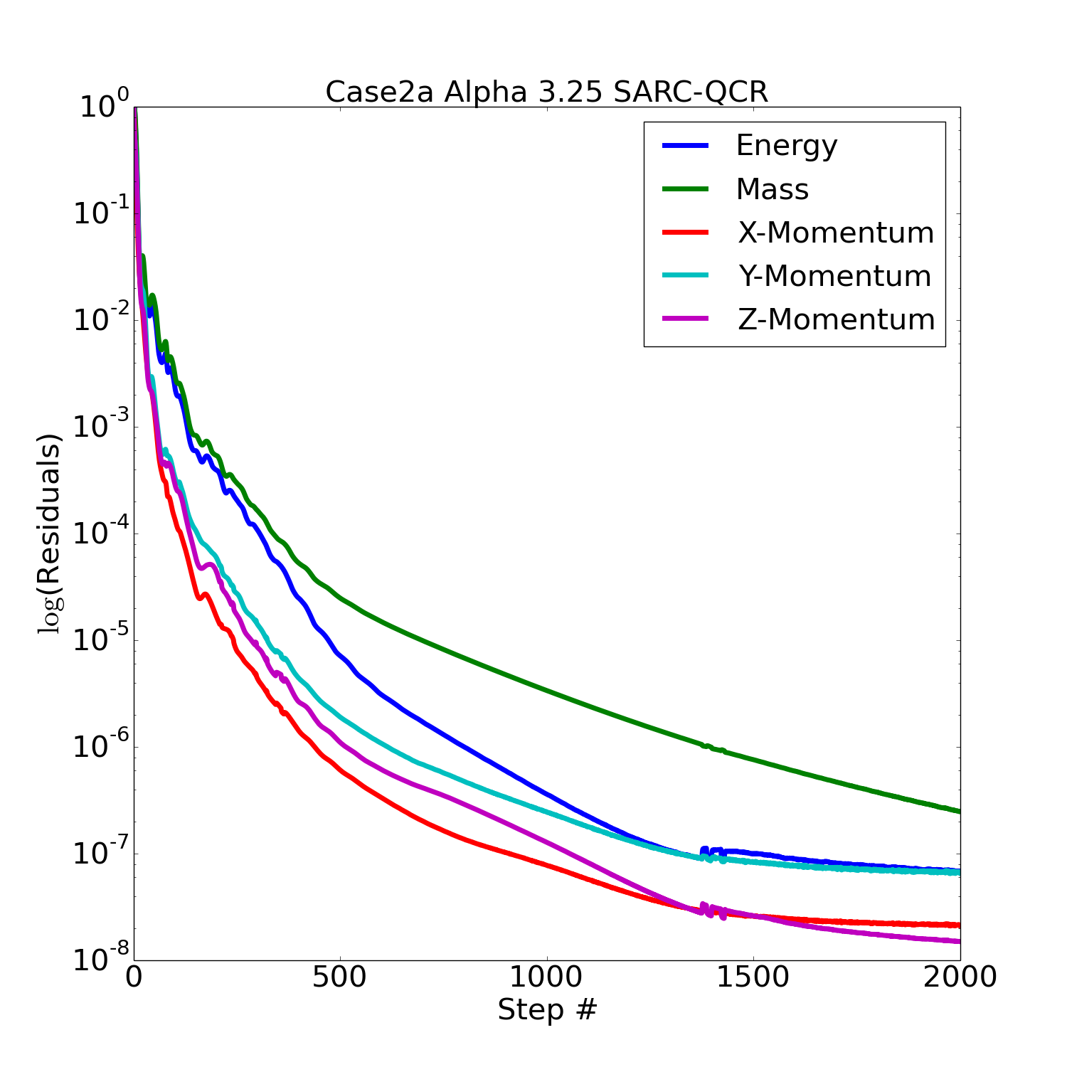
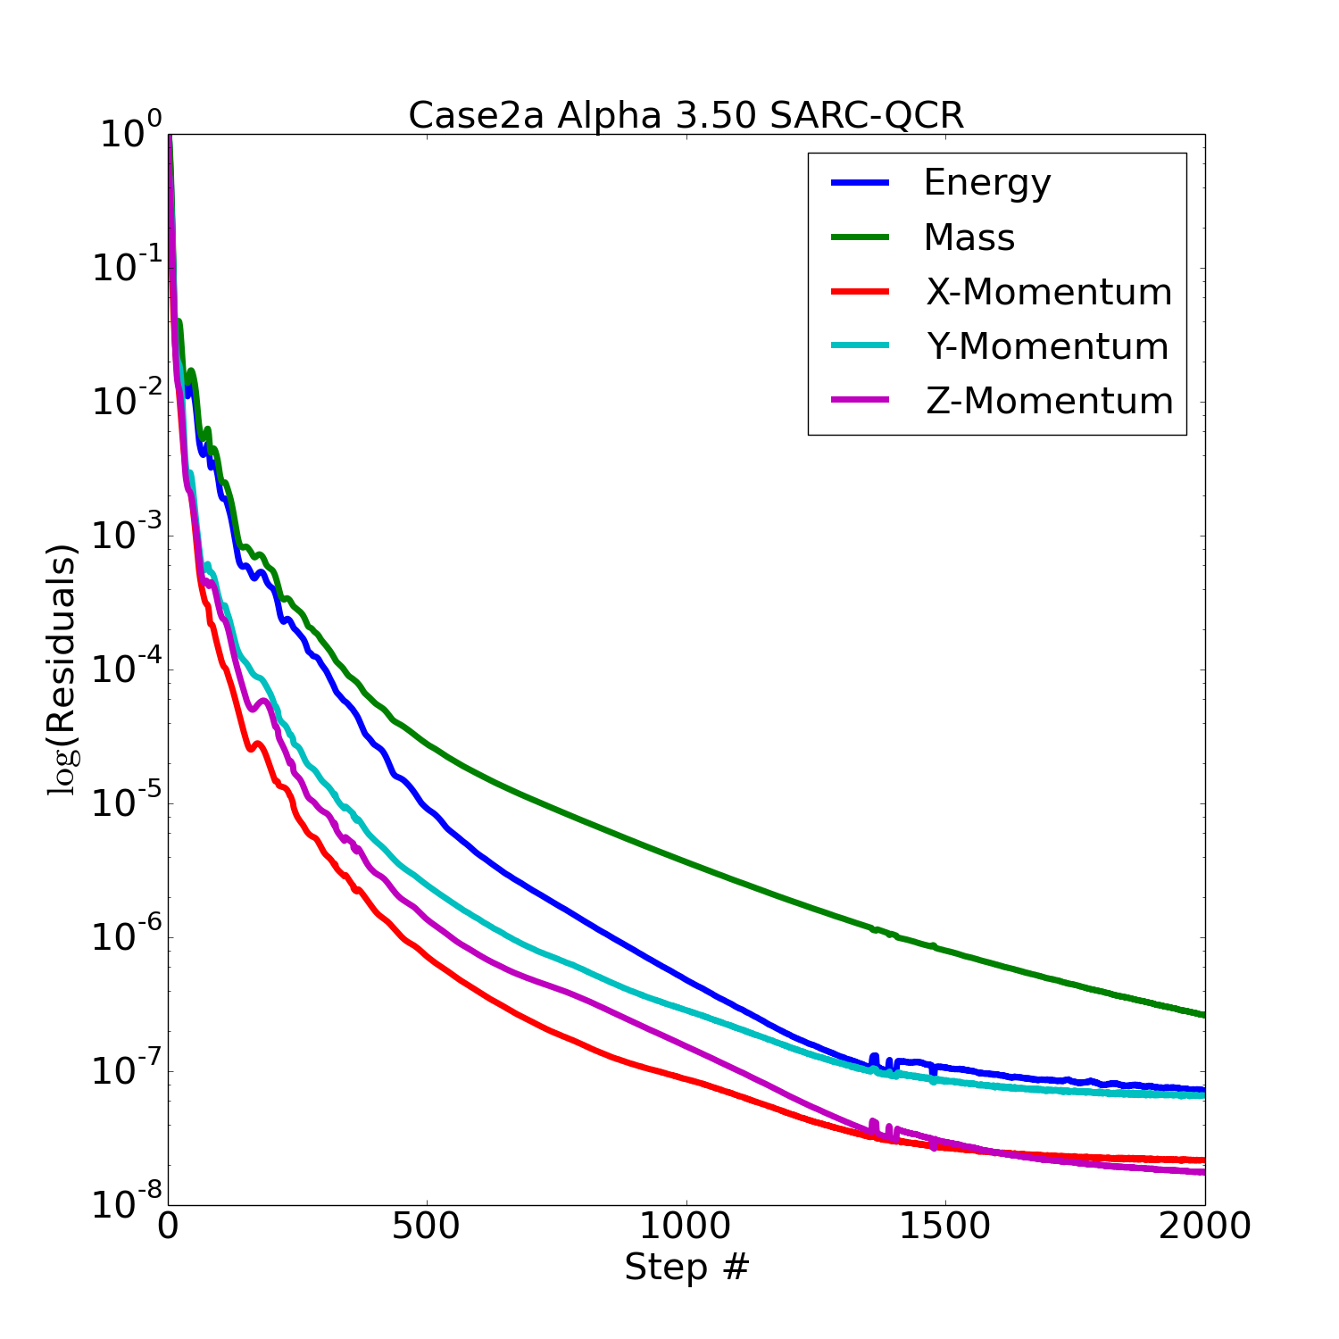
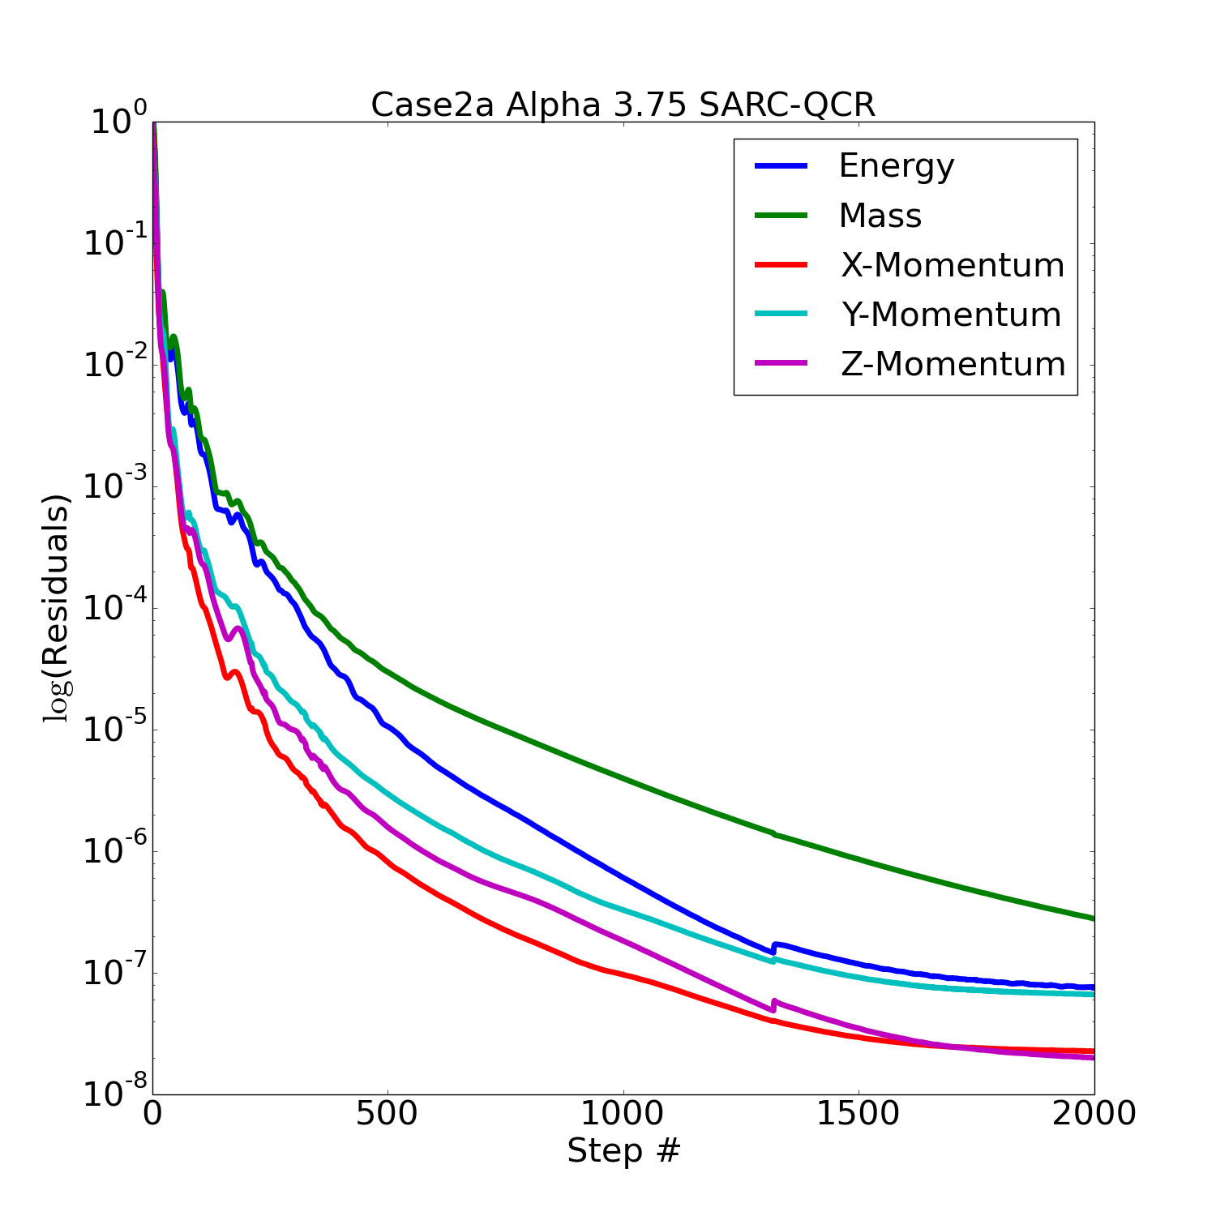
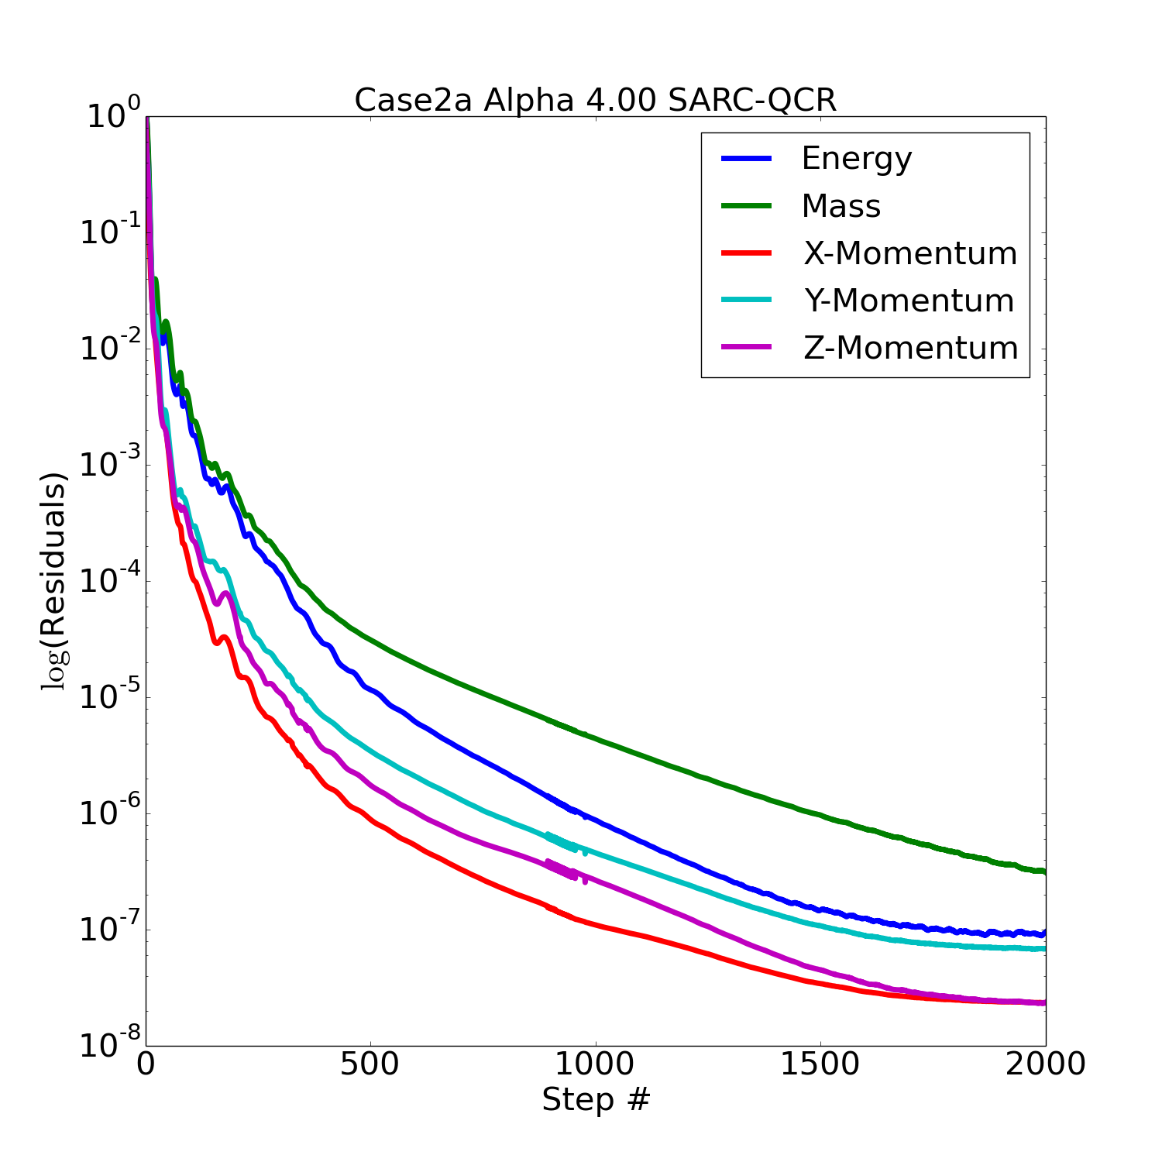
Alpha-Sweep Residuals: SARC+QCR, Re=4M
α = 2.75˚
α = 3.00˚
α = 3.25˚
α = 3.50˚
α = 3.75˚
α = 4.00˚
Notes:
OLD

Slide 16
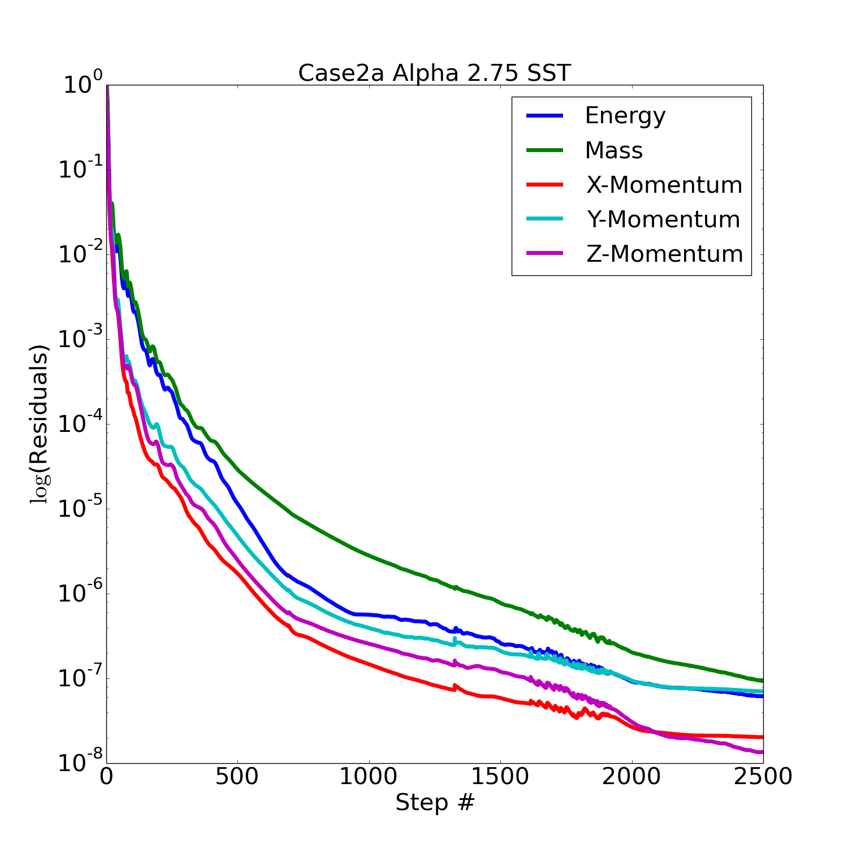
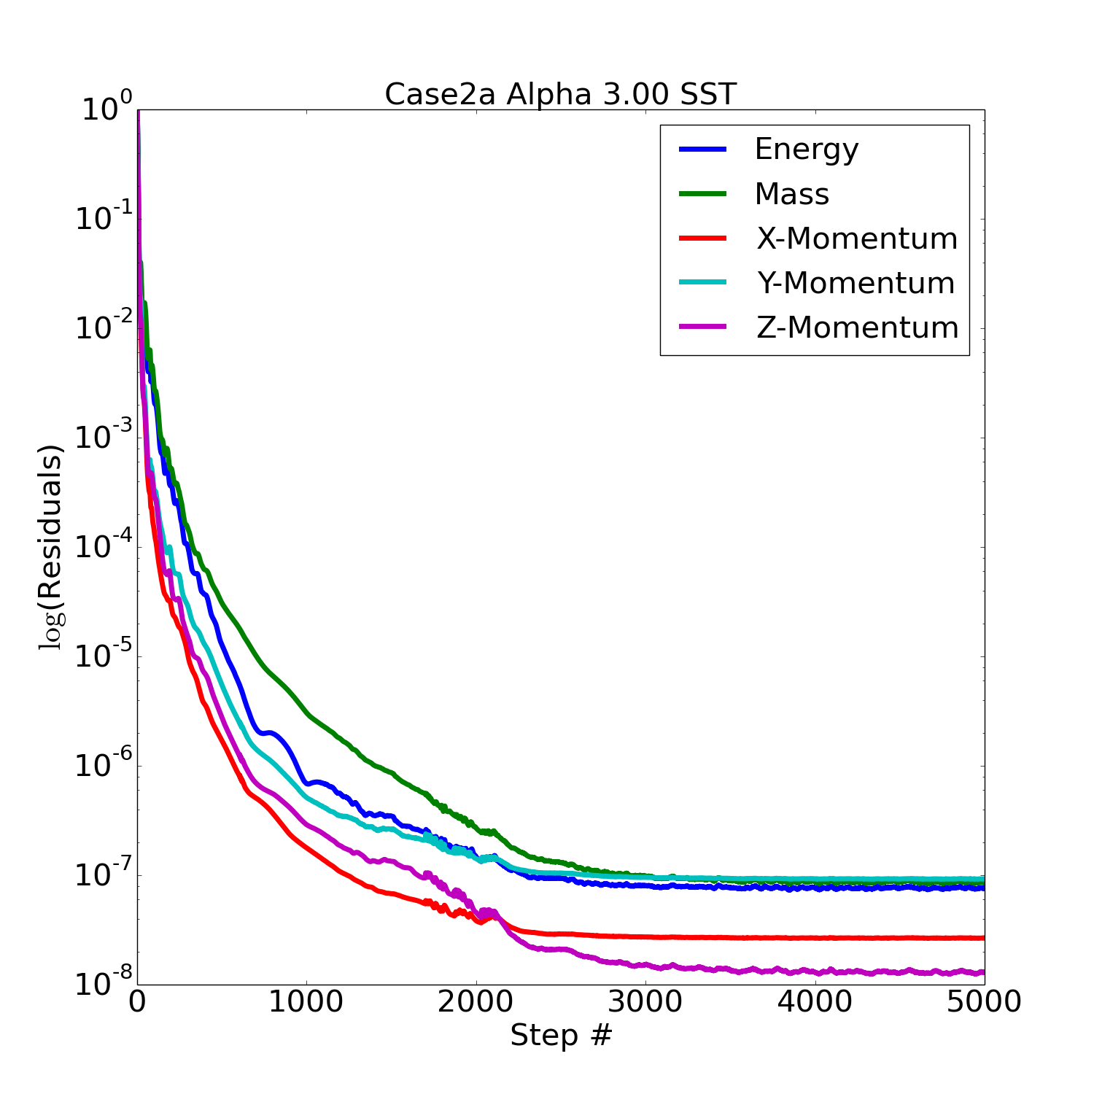
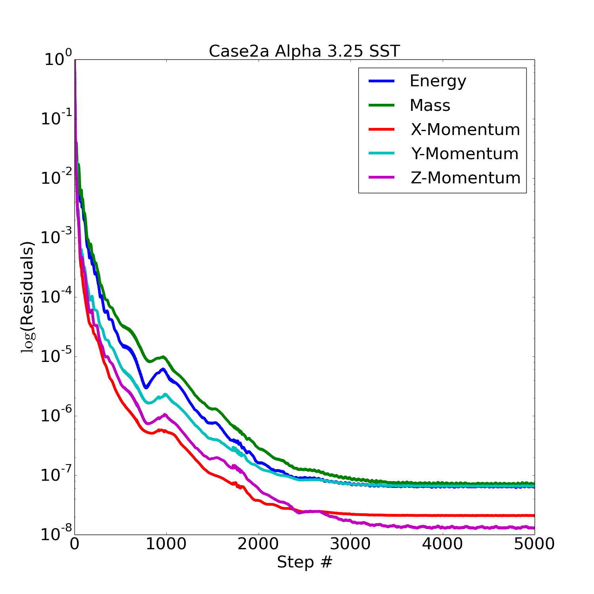
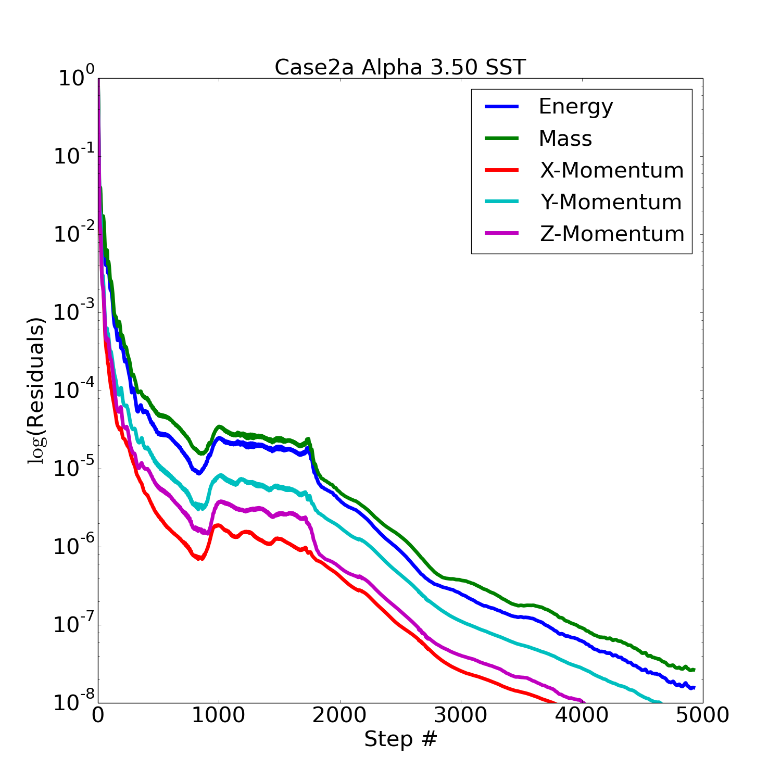
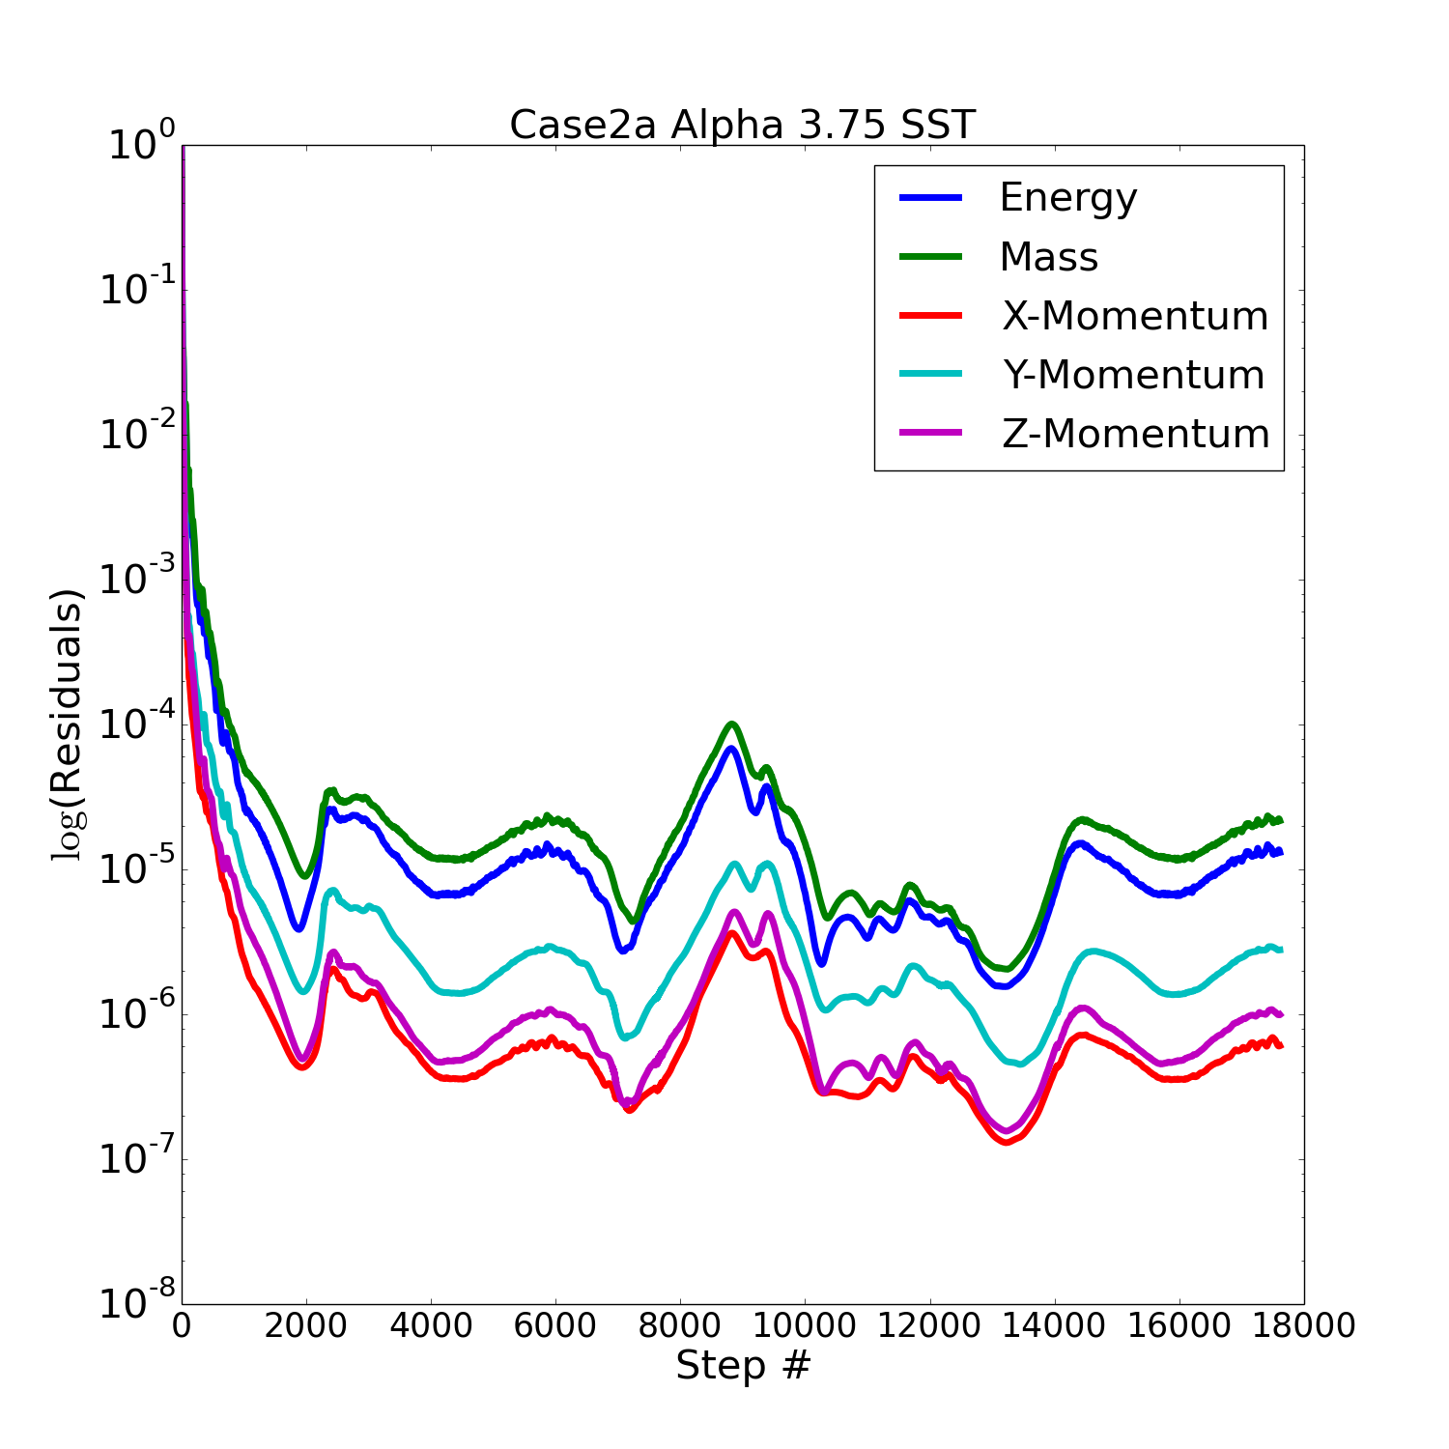
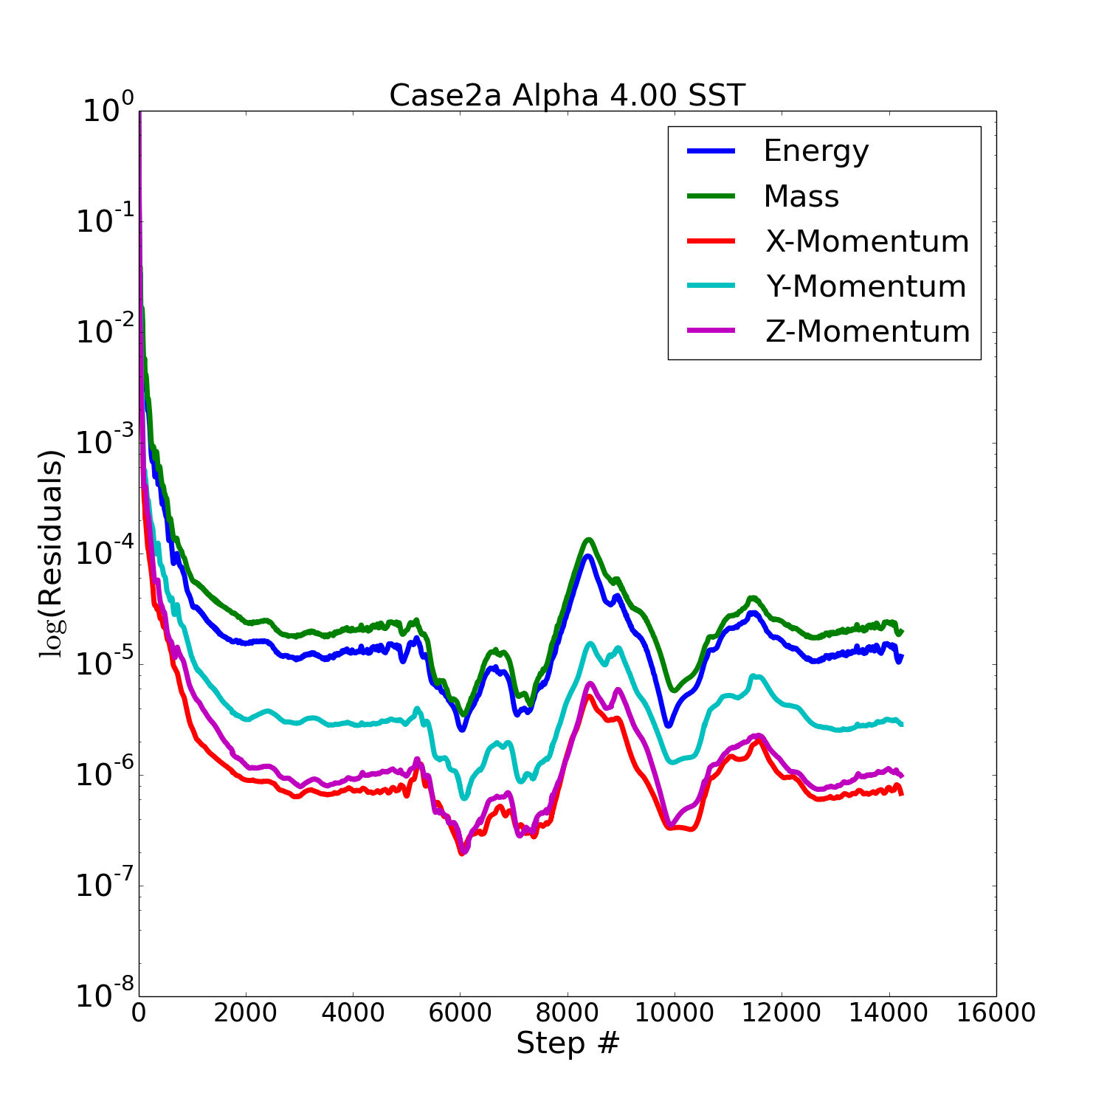
Alpha-Sweep Residuals: SST, Re=4M
α = 2.75˚
α = 3.00˚
α = 3.25˚
α = 3.50˚
α = 3.75˚
α = 4.00˚
Notes:
OLD

Slide 17
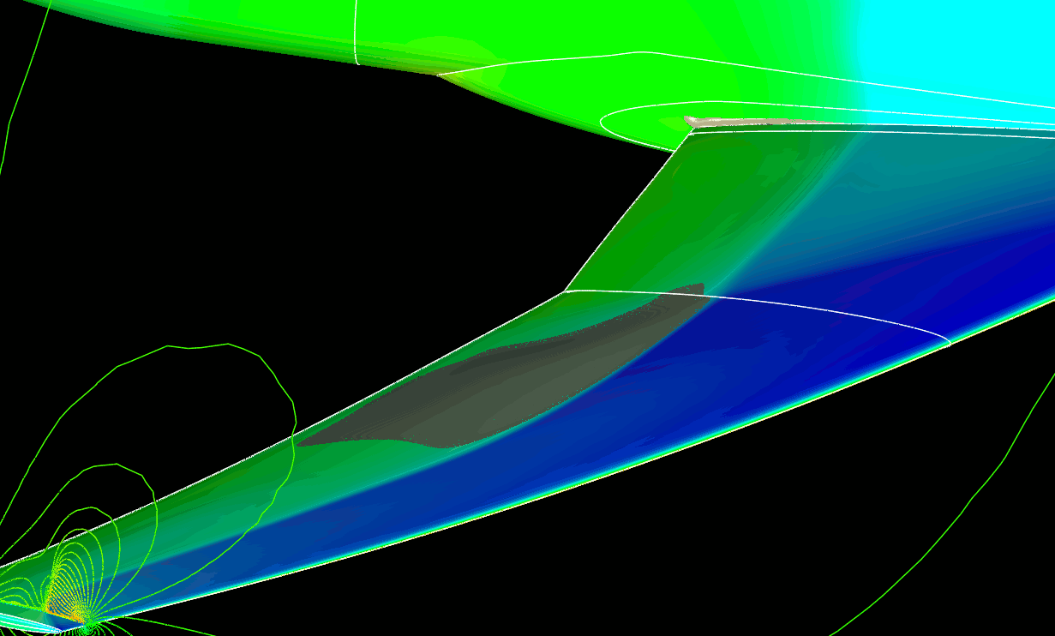
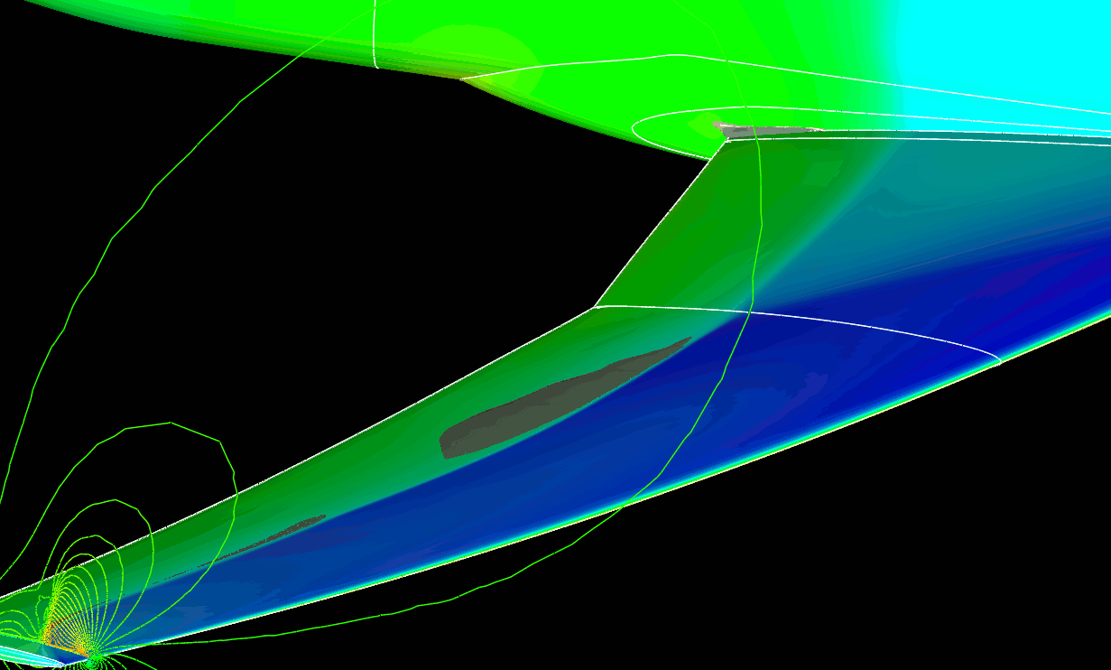
Cross-Section Mach Contours and Separation Re=4M
Isosurface Comparisons
α=4.00˚: SARC-QCR (Left) and SST/Start Soln nt=8900 (Right)
Aircraft surface: Pressure
Isosurface: -1 m/s x-velocity component
Cutplane: Mach number

Slide 18
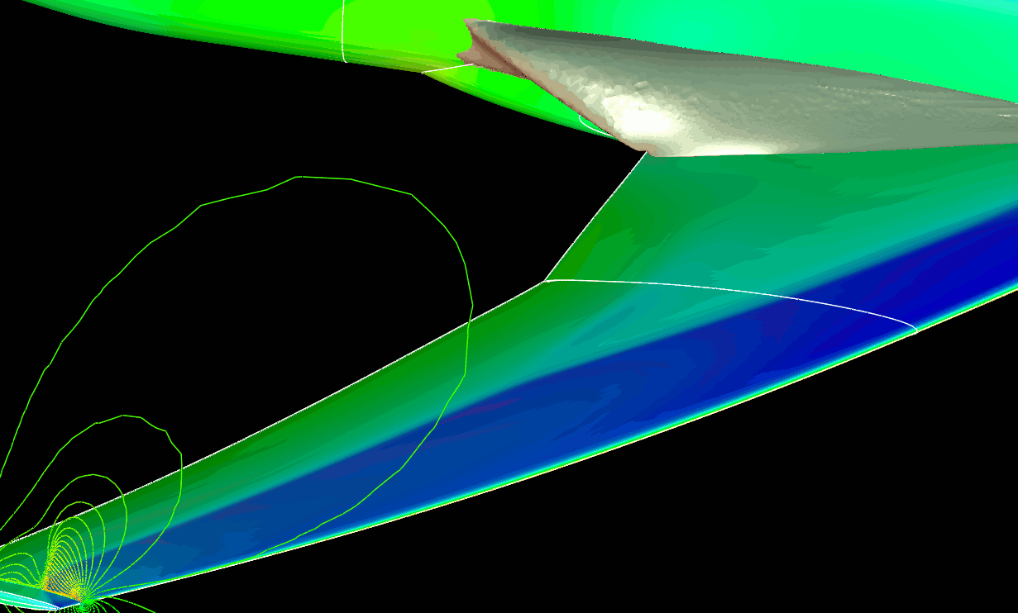
Cross-Section Mach Contours and Separation Re=4M
Isosurface Comparisons
α=4.00˚: SARC-QCR (Left) and SST/Cont Soln nt=14200 (Right)
Aircraft surface: Pressure
Isosurface: -1 m/s x-velocity component
Cutplane: Mach number

Slide 19
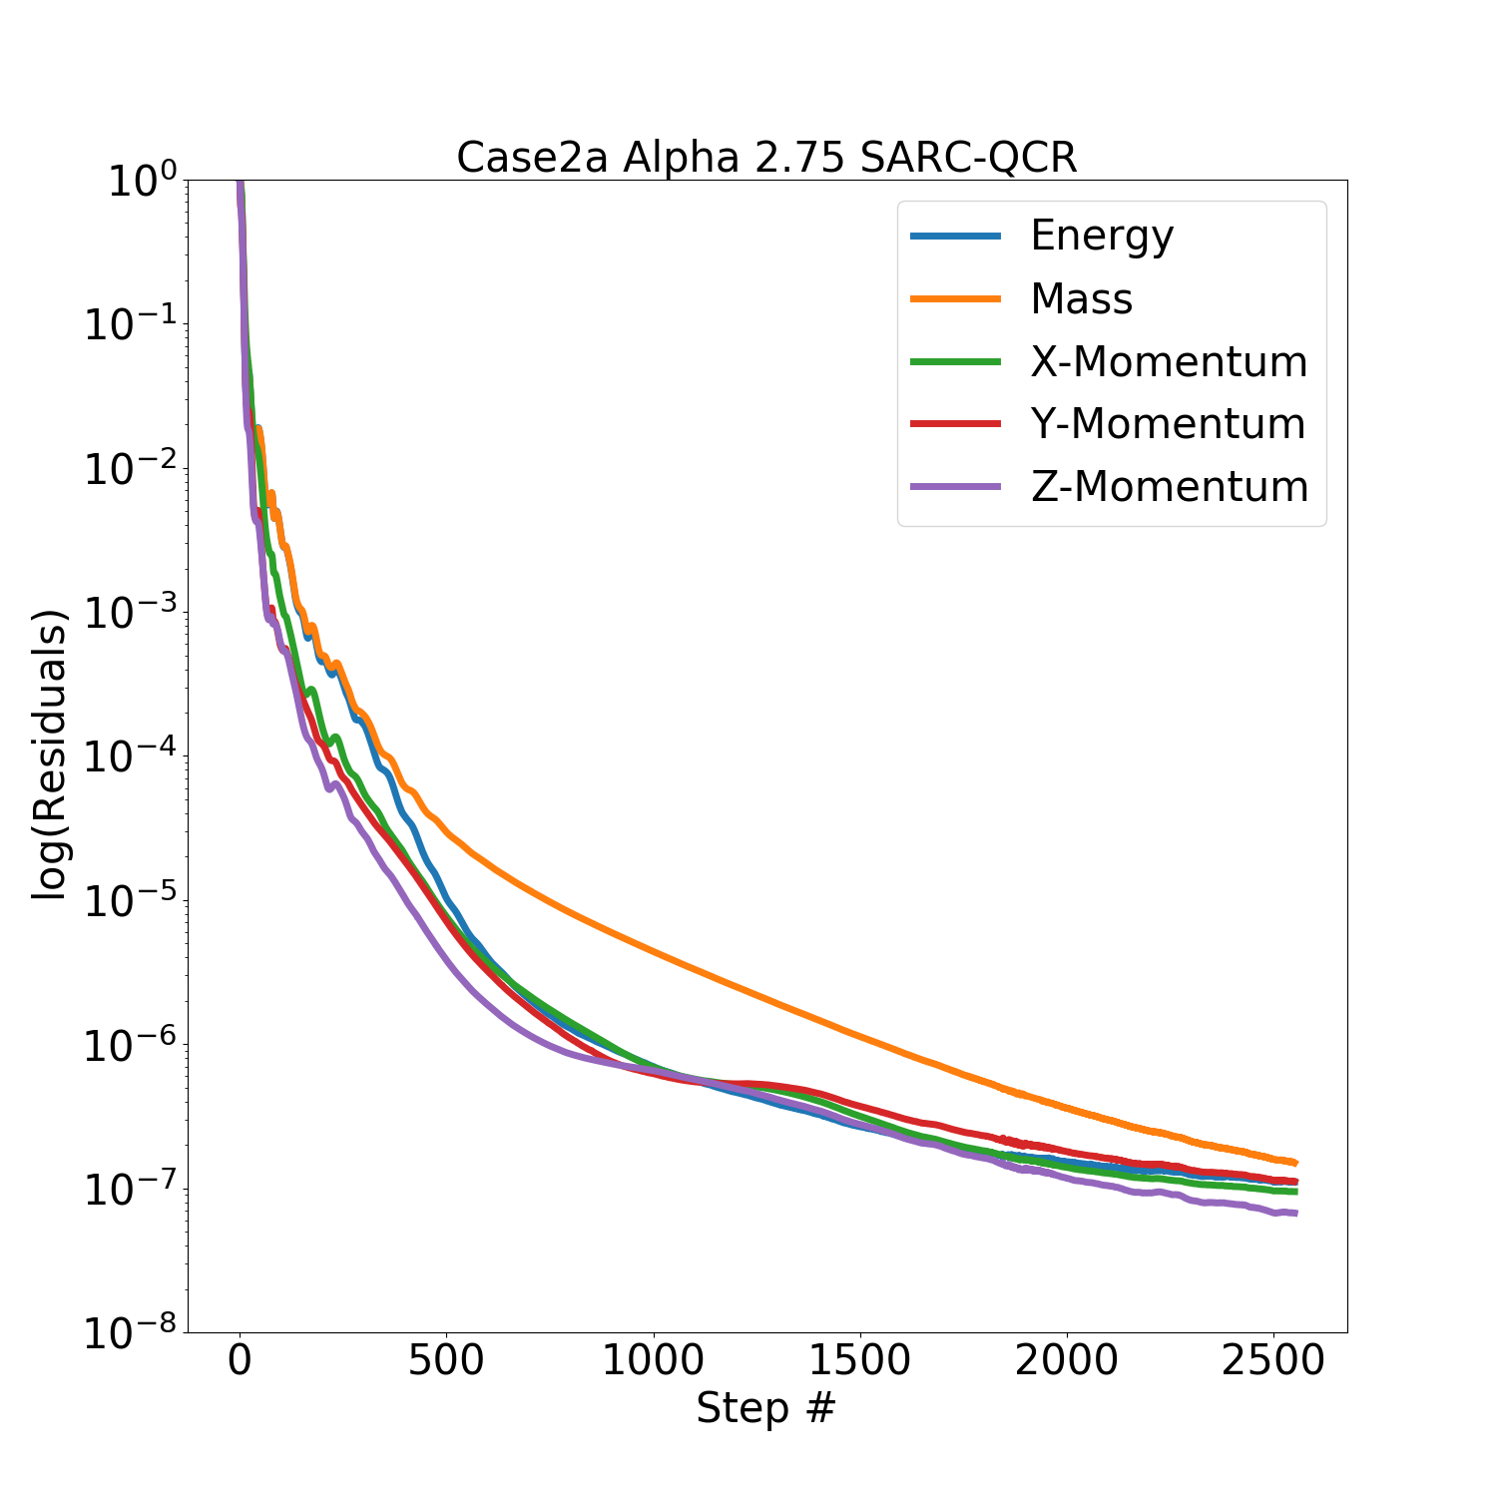
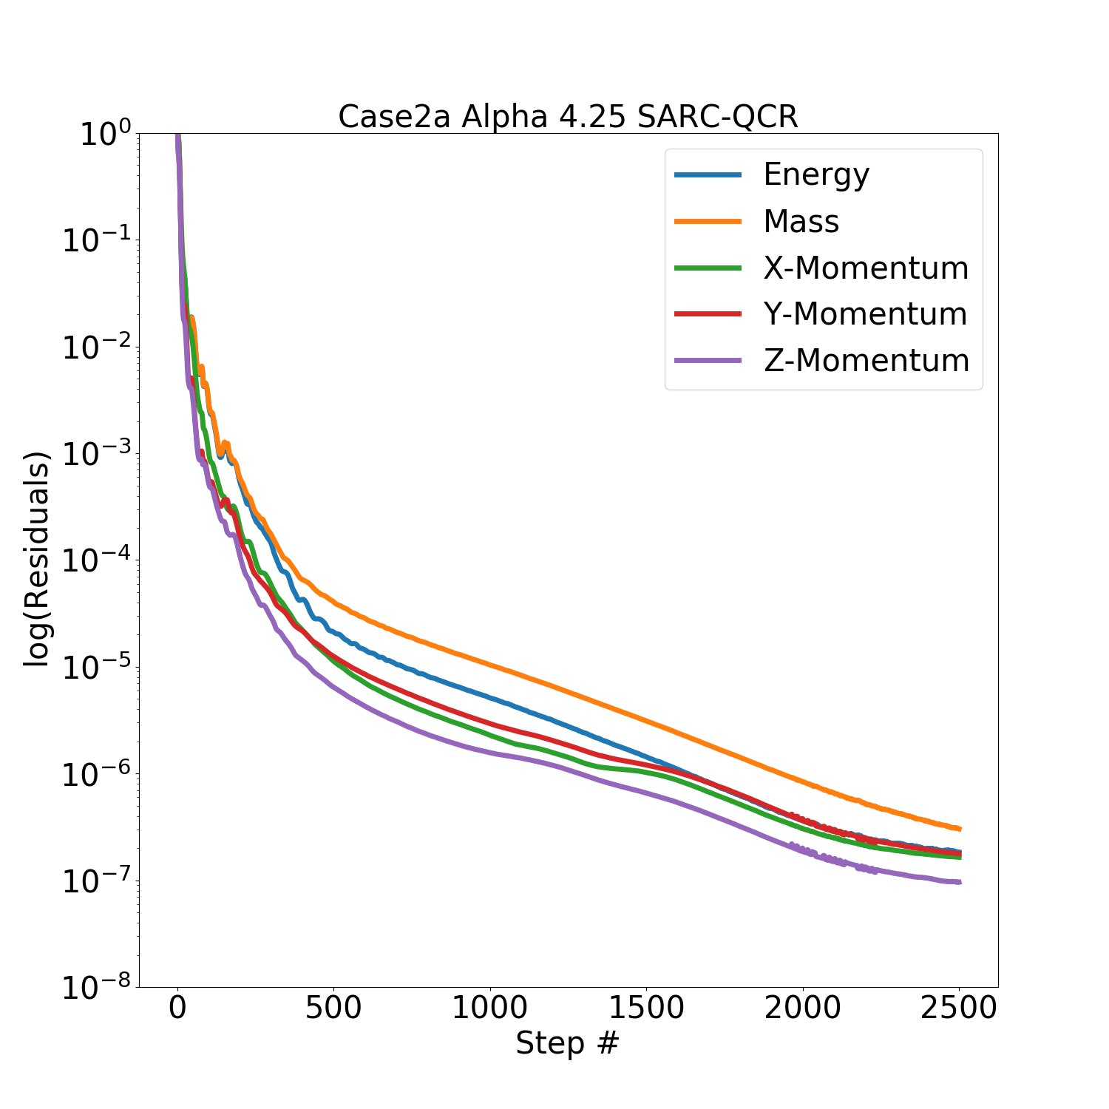
Alpha-Sweep Residuals: SARC+QCR, Re=20M
α = 2.75˚
α = 4.25˚
Notes:
OLD

Slide 20
Case 2a : Wing-Body Alpha Sweep
Shock-induced separation from 2.75˚
Side-of-body separation in all cases
α | C_{L} | C_{D}
2.23˚ | 0.50 | 0.022517
2.75˚ | 0.577272 | 0.027241
3.00˚ | 0.609559 | 0.030213
3.25˚ | 0.633715 | 0.033557
3.50˚ | 0.651930 | 0.038059
3.75˚ | 0.669637 | 0.041414
4.00˚ | 0.686953 | 0.045781
4.25˚ | 0.703539 | 0.050348

Slide 21
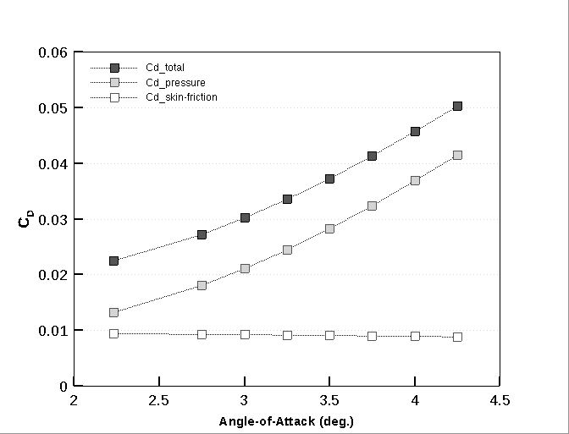
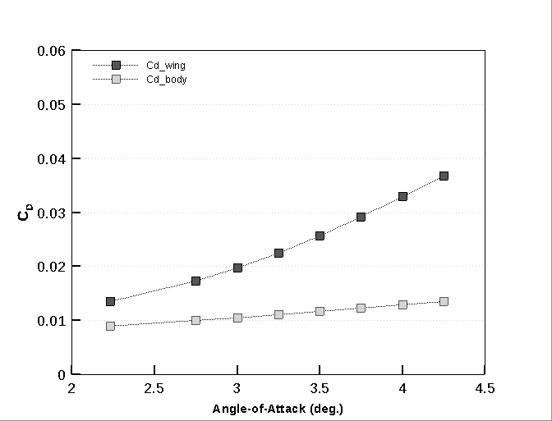
Case 2a : Wing-Body Alpha Sweep
Drag Components
Wing/Body Contribution

Slide 22
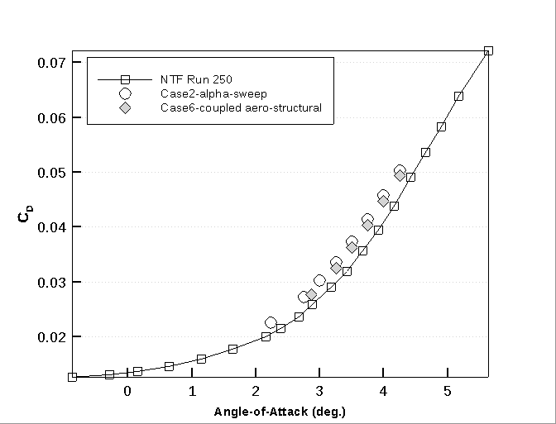
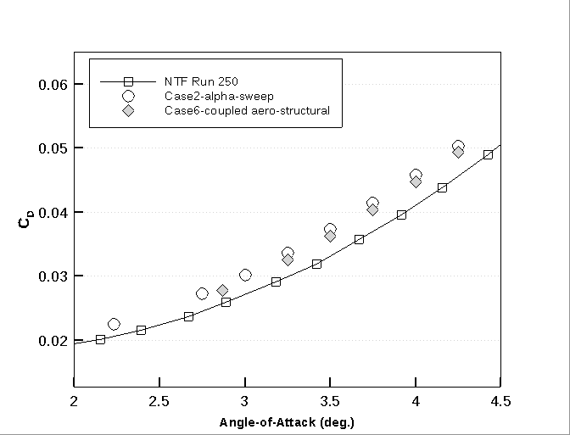
Case 2a : Wing-Body Alpha Sweep
Drag Coefficient
No sting correction applied to NTF data

Slide 23
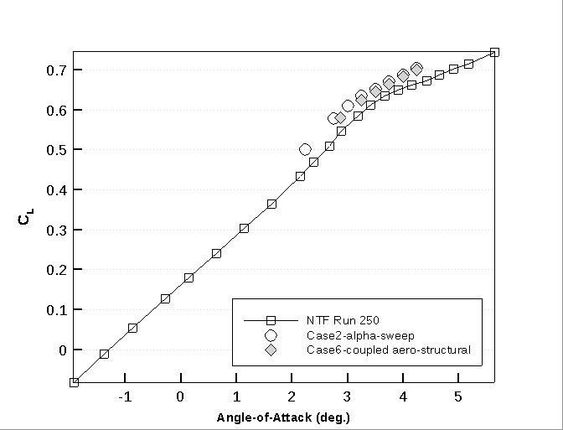
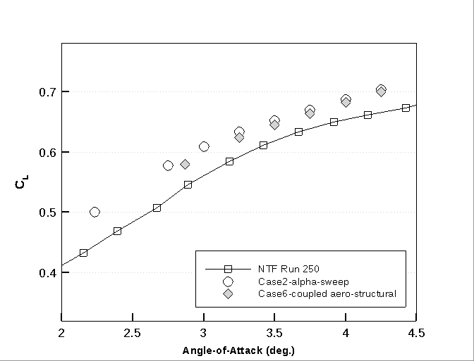
Case 2a : Wing-Body Alpha Sweep
Lift Coefficient
No sting correction applied to NTF data

Slide 24
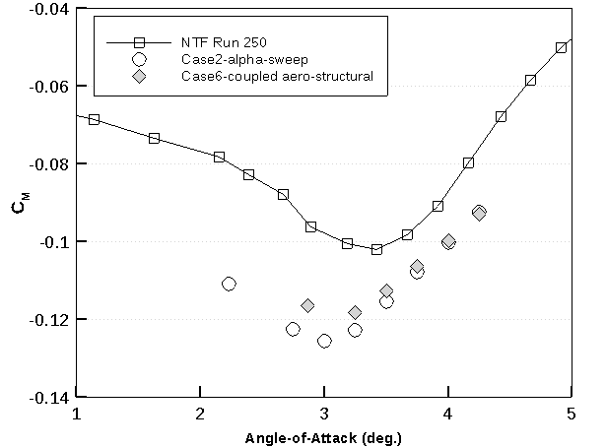
Case 2a : Wing-Body Alpha Sweep
Pitching Moment Coefficient
Corrections applied to NTF tunnel data:
Model blockage
Wake blockage
Tunnel buoyancy
Lift interference
No sting correction applied to NTF data

Slide 25
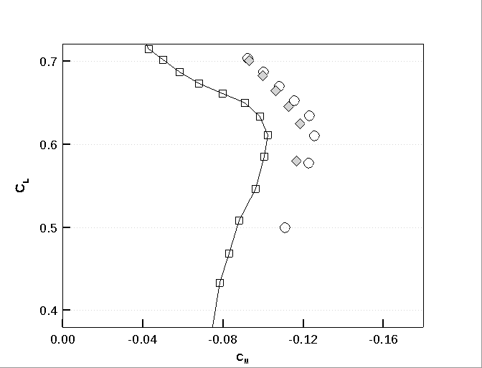
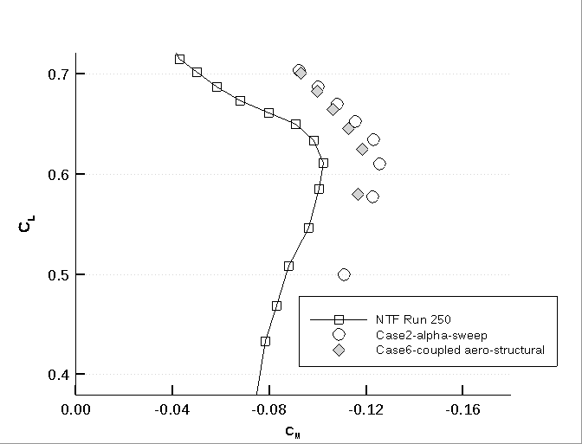
Case 2a : Wing-Body Alpha Sweep
C_{M} vs C_{L}
Many tunnel installation effects can cause a shift:
Error in true alpha measurement
Error in moment-center offset
Model/mount aeroelastic effects
Unknown effects of tunnel corrections
No sting correction applied to NTF data

Slide 26
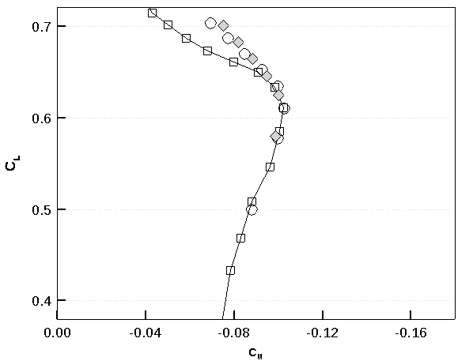
Case 2a : Wing-Body Alpha Sweep
C_{M} vs C_{L} – with shift in C_{M}
No sting correction applied to NTF data

Slide 27
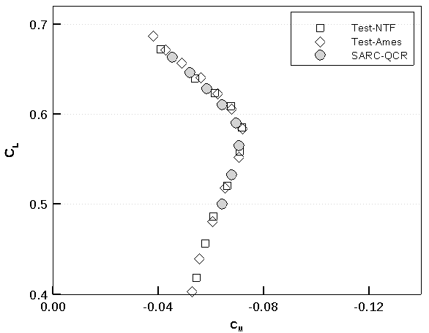
Case 2a : Wing-Body Alpha Sweep
C_{M} vs C_{L} – with shift in C_{M}
Re: 4 million
Mach 0.85
T = -250˚ F
Angle-of-Attack Sweep from 2.50˚ to 4.25˚
Test-NTF : (Re 5M)
Test-Ames : (Re 5M)
No sting correction applied to NTF data
Notes:
Presumably this good agreement is a bit fortuitous, because this NTF data also wouldn’t have a sting correction applied?

Slide 28

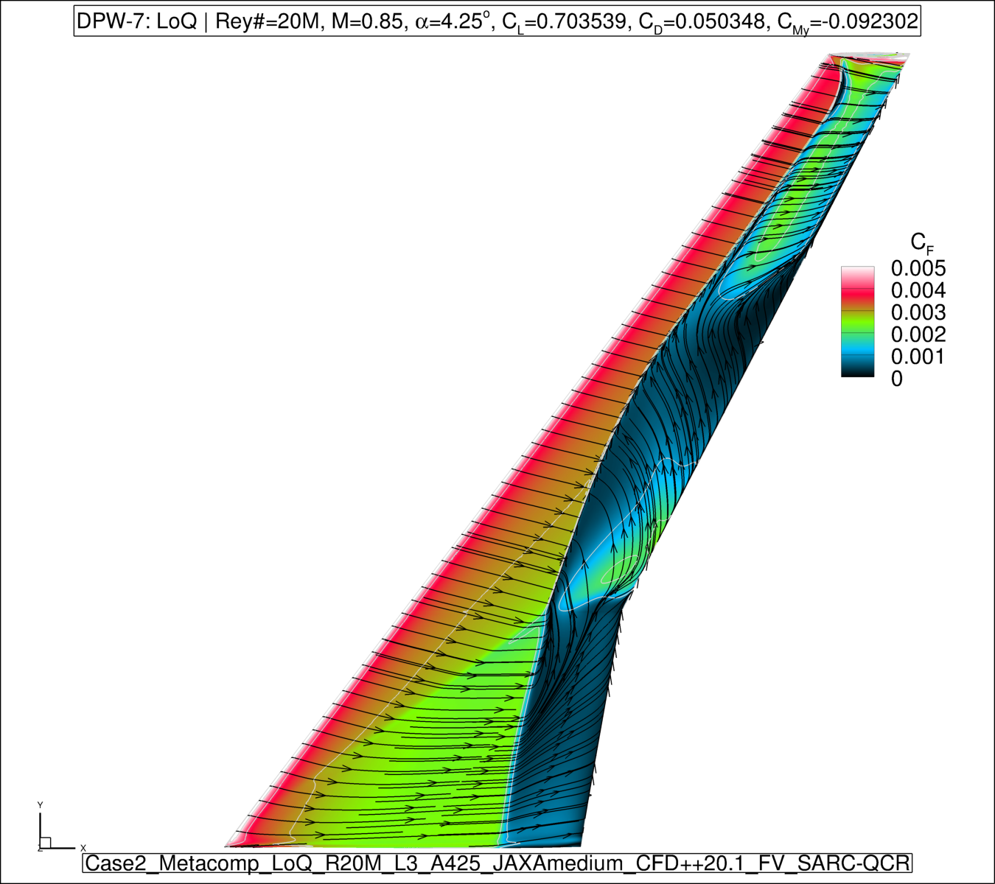
Case 2a : Wing-Body Alpha Sweep
α=2.75˚SARC-QCR
α=4.25˚SARC-QCR

Slide 29
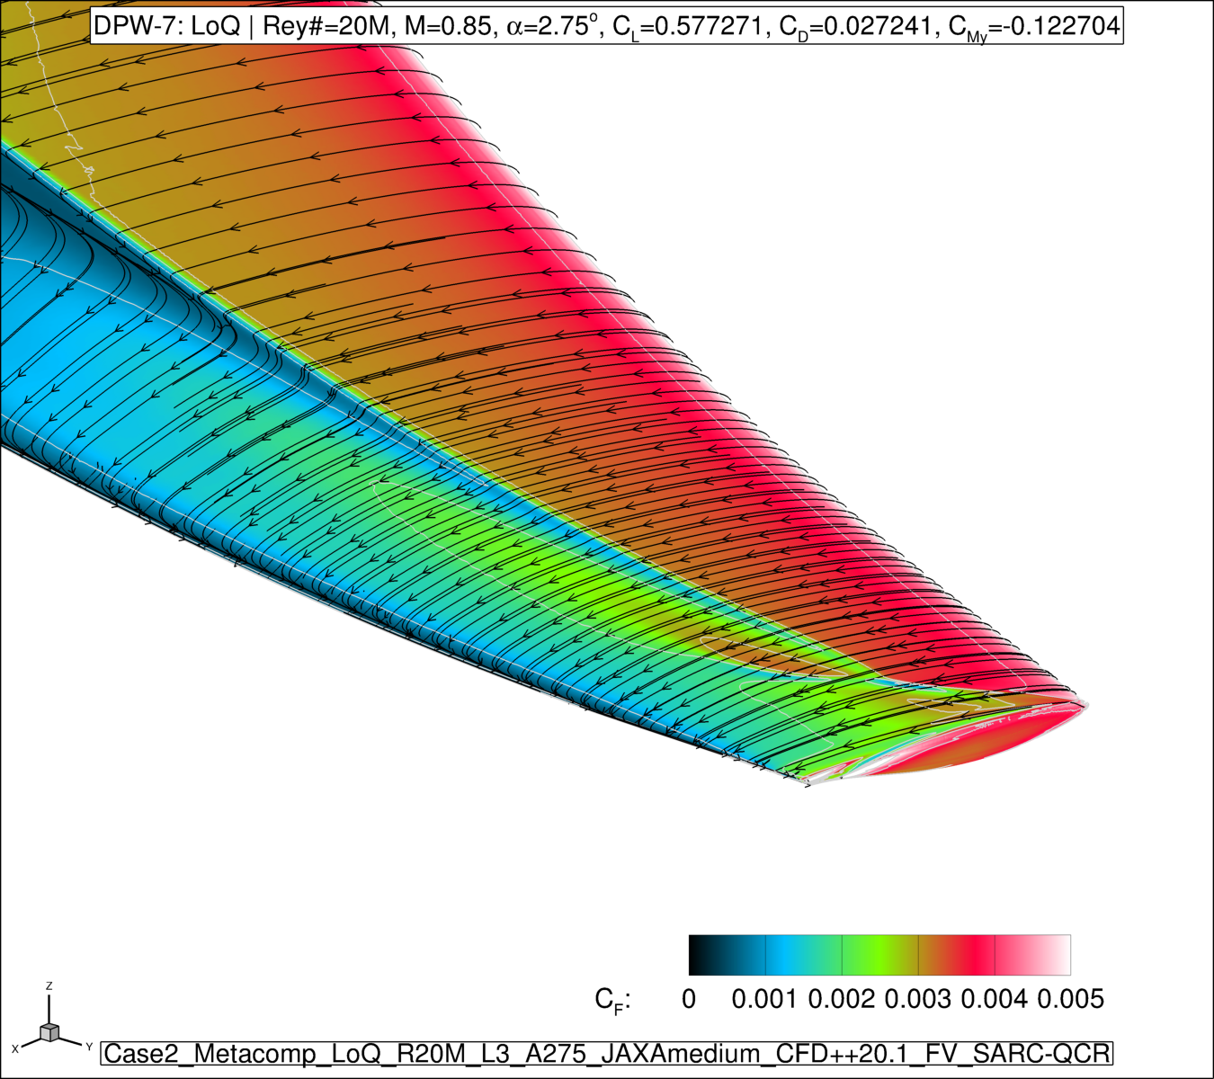
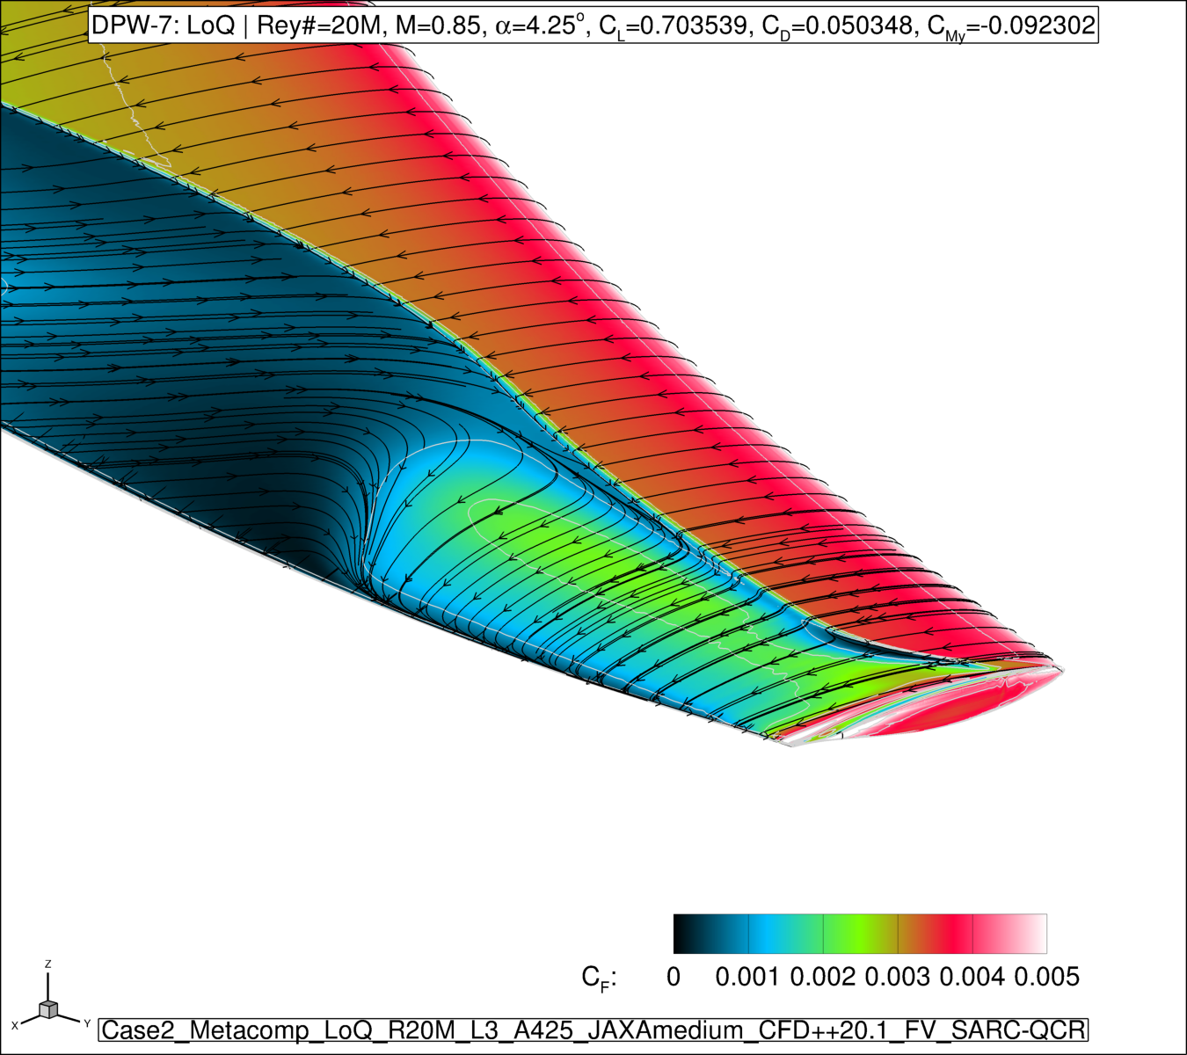
Case 2a : Wing-Body Alpha Sweep
α=2.75˚SARC-QCR
α=4.25˚SARC-QCR

Slide 30
Case 3 : Reynolds Number Sweep (C_{L}=0.50)
Reynolds Sweep at Constant Cl=0.50 and Mach 0.85
Medium JAXA grids
CFD++ Compressible RANS (Air, Perfect Gas)
Turbulence Model: SARC-QCR
All simulations run with C_{L}-driver
Reynolds # | P_{static} (kPa) | T_{static} (˚K) | U∞ (m/s) | q (kPa)
5M LoQ | 125 | 271.67 | 280.92 | 63
20M LoQ | 127 | 101.77 | 171.94 | 64
20M HiQ | 192 | 134.78 | 197.87 | 97
30M HiQ | 189 | 101.78 | 171.94 | 96

Slide 31
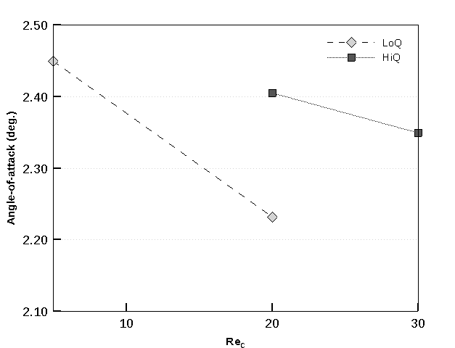
Case 3 : Reynolds Number Effects
No shock induced separation in all cases
Angles-of-attack settle below 2.45˚
Reynolds # | C_{L} | α
5M LoQ | 0.50 | 2.4495˚
20M LoQ | 0.50 | 2.2314˚
20M HiQ | 0.50 | 2.4046˚
30M HiQ | 0.50 | 2.3489˚

Slide 32
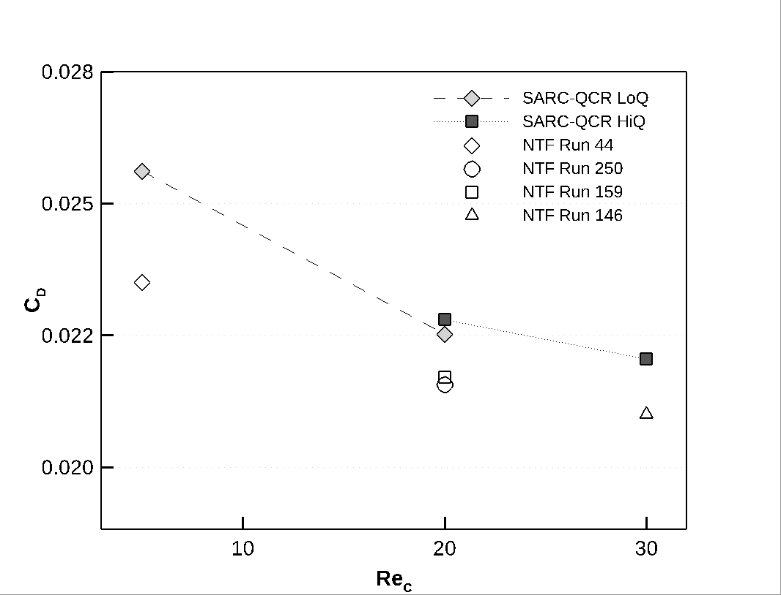
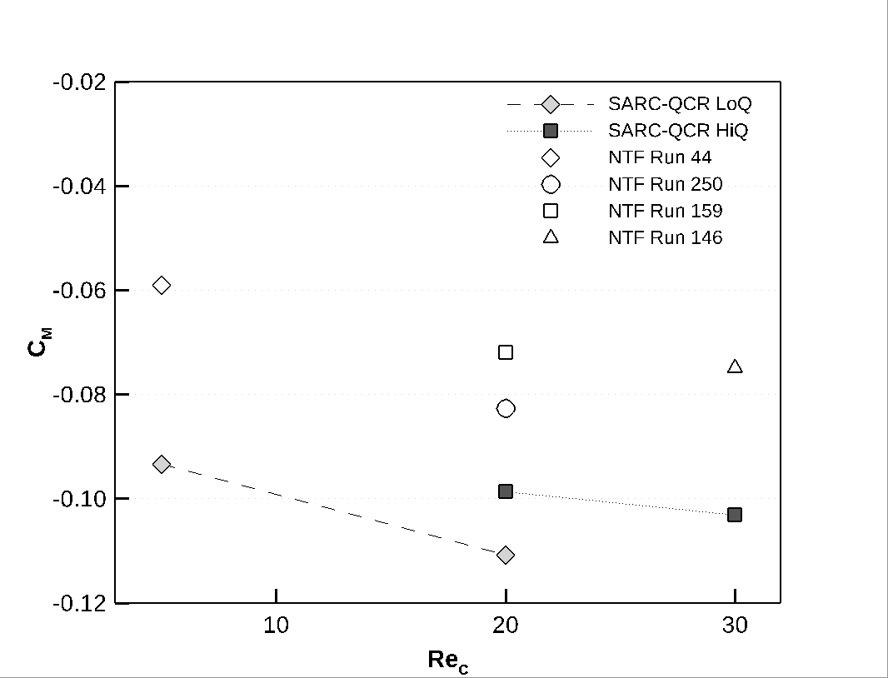
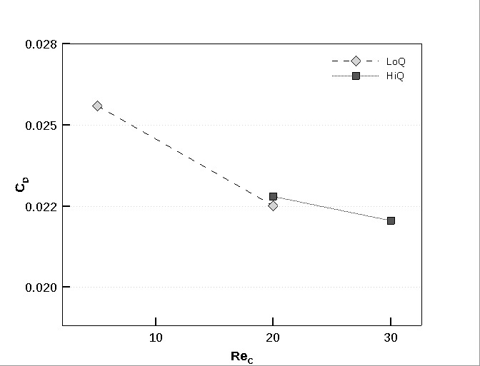
Case 3 : Reynolds Number Effects
Drag Coefficient
Pitching Moment Coefficient
N.B. 5millionLoQ CFD Q=1325 / NTF Run 44 Q=1388
20millionLoQ CFD Q=1338 / NTF Run 250 Q=1313
20millionHiQ CFD Q=2031 / NTF Run 159 Q=1988
30millionHiQ CFD Q=2007 / NTF Run 146 Q=1989
Alphas are approximate and no sting correction applied to NTF data
&

Slide 33
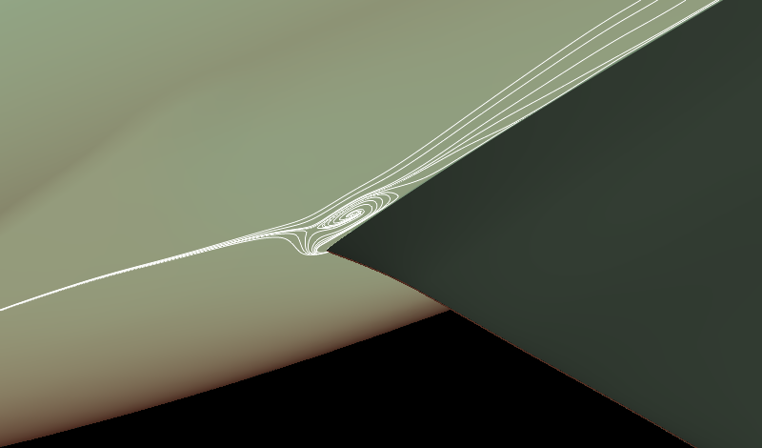

Misc. Observations 1 #1: TE (Shock) & SOB/Wing Separations
SOB separation in terms of vortex eye on body…
… and shock-induced separation location: Both unambiguous for all cases
In most cases wing separation is more complicated…

Slide 34


Which Vortex Eye Do We Want?
λ₂ isosurface
Q-criterion isosurface

Slide 35

Which Vortex Eye Do We Want?
λ₂ /Q-criterion isosurfaces:

Slide 36

Which Vortex Eye Do We Want?
Surface and volume streamlines

Slide 37
Case 1a : Juncture-Region SOB Separation

Slide 38

Case 1a : Juncture-Region SOB Separation
SOB separation: Tiny mesh

Slide 39

Case 1a : Juncture-Region SOB Separation
SOB separation: Coarse mesh

Slide 40

Case 1a : Juncture-Region SOB Separation
SOB separation: Medium mesh

Slide 41

Case 1a : Juncture-Region SOB Separation
SOB separation: Fine mesh

Slide 42

Case 1a : Juncture-Region SOB Separation
SOB separation: Extra Fine mesh

Slide 43

Case 1a : Juncture-Region SOB Separation
SOB separation: Ultra Fine mesh

Slide 44
Case 1a : Juncture-Region Wing Separation

Slide 45

Case 1a : Juncture-Region Wing Separation
Wing separation: Tiny mesh

Slide 46

Case 1a : Juncture-Region Wing Separation
Wing separation: Coarse mesh

Slide 47

Case 1a : Juncture-Region Wing Separation
Wing separation: Medium mesh

Slide 48

Case 1a : Juncture-Region Wing Separation
Wing separation: Fine mesh

Slide 49

Case 1a : Juncture-Region Wing Separation
Wing separation: Extra Fine mesh

Slide 50

Case 1a : Juncture-Region Wing Separation
Wing separation: Ultra Fine mesh

Slide 51

Case 1a : Juncture-Region Mesh
Tiny mesh

Slide 52

Case 1a : Juncture-Region Mesh
Coarse mesh

Slide 53

Case 1a : Juncture-Region Mesh
Medium mesh

Slide 54

Case 1a : Juncture-Region Mesh
Fine mesh

Slide 55

Case 1a : Juncture-Region Mesh
ExtraFine mesh

Slide 56

Case 1a : Juncture-Region Mesh
UltraFine mesh

Slide 57

Case 1a : Juncture-Region Mesh
UltraFine mesh + surface srteamlines

Slide 58
Case 2a : Juncture-Region Wing Separation

Slide 59

Case 2a : Juncture-Region Wing Separation
Wing separation: C_{L}=0.50 2.50˚ LoQ AE CRM geometry

Slide 60

Case 2a : Juncture-Region Wing Separation
Wing separation: α=2.75˚ 2.75˚ LoQ AE CRM geometry

Slide 61

Case 2a : Juncture-Region Wing Separation
Wing separation: α=3.00˚ 3.00˚ LoQ AE CRM geometry

Slide 62

Case 2a : Juncture-Region Wing Separation
Wing separation: α=3.25˚ 3.25˚ LoQ AE CRM geometry

Slide 63

Case 2a : Juncture-Region Wing Separation
Wing separation: α=3.50˚ 3.50˚ LoQ AE CRM geometry

Slide 64

Case 2a : Juncture-Region Wing Separation
Wing separation: α=3.75˚ 3.75˚ LoQ AE CRM geometry

Slide 65

Case 2a : Juncture-Region Wing Separation
Wing separation: α=4.00˚ 4.00˚ LoQ AE CRM geometry

Slide 66

Case 2a : Juncture-Region Wing Separation
Wing separation: α=4.25˚ 4.25˚ LoQ AE CRM geometry

Slide 67
Case 3 : Juncture-Region Wing Separation

Slide 68

Case 3 : Juncture-Region Wing Separation
Wing separation: Re=5M, C_{L}=0.50 2.50˚ LoQ AE CRM geometry

Slide 69
Case 3 : Juncture-Region Wing Separation
Wing separation: Re=20M, C_{L}=0.50* 2.50˚ LoQ AE CRM geometry *(same as Case 2a, C_{L}=0.50)

Slide 70

Case 3 : Juncture-Region Wing Separation
Wing separation: Re=20M, C_{L}=0.50 2.50˚ HiQ AE CRM geometry

Slide 71

Case 3 : Juncture-Region Wing Separation
Wing separation: Re=30M, C_{L}=0.50 2.50˚ HiQ AE CRM geometry

Slide 72
Case 6 : Juncture-Region Wing Separation

Slide 73

Case 6 : Juncture-Region Wing Separation
Wing separation: C_{L}=0.58
q/E=0.334 x10⁻⁶

Slide 74

Case 6 : Juncture-Region Wing Separation
Wing separation: α=3.25˚
q/E=0.334 x10⁻⁶

Slide 75

Case 6 : Juncture-Region Wing Separation
Wing separation: α=3.50˚
q/E=0.334 x10⁻⁶

Slide 76

Case 6 : Juncture-Region Wing Separation
Wing separation: α=3.75˚
q/E=0.334 x10⁻⁶

Slide 77

Case 6 : Juncture-Region Wing Separation
Wing separation: α=4.00˚
q/E=0.334 x10⁻⁶

Slide 78

Case 6 : Juncture-Region Wing Separation
Wing separation: α=4.25˚
q/E=0.334 x10⁻⁶

Slide 79

Misc. Observations 2 #2: Confirmation of Sectional-Integration Macro
Tecplot macro #3
Direct CFD++ sectional-integration probe
Latest version of Tecplot sectional-integration macro agrees with the built-in sectional integration tool in CFD++

Slide 80
Case 6 : Coupled Aero-Structural
Simulation
CFD++ is coupled with Metacomp’s software suite designed for Fluid-Structure Interaction:
CSM++ : An in-house finite-element based structural mechanics and dynamics package
MetaFSI: A suite of tools designed to
Transfer loads from CFD++ to CSM++
Morph the CFD++ mesh based on structural displacements
FSI
CSM++
CFD++
MetaFSI

Slide 81
FE Model: Eigenvalue Analysis
Start with the FE model for wing/body/tail=0˚ configuration from NASA CRM website
Create a wing/body configuration by removing all elements making up the horizontal tail
Import NASTRAN model in to CSM++ and run modal analysis for both configurations
Compare frequencies and mode shapes from CSM++ with Prof. Mavriplis’ results (Abaqus)
Mode # | CSM++ (Wing/Body) | CSM++ (Wing/Body/Tail=0˚) | Prof. Mavriplis
1 | 38.157 Hz (-3.06%) | 38.147 Hz (-3.08%) | 39.360 Hz
2 | 39.561 Hz (-3.37 %) | 39.535 Hz (-3.44 %) | 40.942 Hz
Notes:
Talk about asymmetry

Slide 82
FE Model: Adjusted Eigenvalue Analysis
Flow conditions: Mach 0.85, Re=20M, T_{total}=116˚ K
Default value of Young’s Modulus of the wing in FEM Model: E = 1.827x10¹¹ N/m²
This resulted in a q/E of 0.351, higher than the intended q/E of 0.334!
Young’s Modulus adjusted to E = 1.918x10¹¹ N/m² to match test case definition
Mode # | CSM++ (Wing/Body) | CSM++ (Wing/Body/Tail=0˚) | Prof. Mavriplis
1 | 38.991 Hz (-0.94%) | 38.979 Hz (-0.97%) | 39.360 Hz
2 | 40.432 Hz (-1.25%) | 39.535 Hz (-1.32%) | 40.942 Hz
Notes:
Talk about unclear Ttotal (maybe), and unclear q/E (maybe). Primarily, first 2 modes important to predict static aeroelastic deflection

Slide 83


FE Model: Mode Shapes Wing/Body/Tail=0˚
Mode 2: 40.401 Hz
Mode 1: 38.979 Hz

Slide 84


FE Model: Mode Shapes Wing/Body
Mode 2: 40.432 Hz
Mode 1: 38.991 Hz

Slide 85

Simulation Strategy
Full aircraft model with ~ 4 million DoFs
Linear tetrahedral solid elements, bushing springs and kinematic rigid body elements
Linear static analysis during FSI
Pressure and wall shear from CFD++ transferred to CSM++ using nearest-neighbor interpolation
Computed deformations sent back to MetaFSI for mesh morphing
Repeat till displacements converge to within a tolerance of 1x10⁻⁶

Slide 86

Simulation Strategy
CFD++ used a mirrored Medium Baseline NoQ Re=30M grid
164,065,758 x 2 = 328,131,516 cells
Start with a steady-state “rigid” CFD++ run
Restart to begin coupled aero-structural analysis
Run CFD++ for 100 steps between each CFD-CSM coupling step
SARC-QCR turbulence model requires recomputing wall distance function after every FSI iteration

Slide 87


Converging to a solution…
Notes:
Between 15 and 20 FSI iterations depending on the case

Slide 88

Results: Deflected 50%-chord line

Slide 89

Results: Deflected 50%-chord line

Slide 90

Results: Wing Bending Deformation

Slide 91

Results: Wing Bending Deformation

Slide 92

Results: Wing Bending Deformation

Slide 93

Results: Wing Bending Deformation

Slide 94

Results: Wing Bending Deformation
Notes:
Sting corrections???

Slide 95

Results: Total Wing Twist

Slide 96

Results: Total Wing Twist

Slide 97

Results: Wing Twist Deformation

Slide 98

Results: Wing Twist Deformation

Slide 99

Results: Wing Twist Deformation

Slide 100

Results: Wing Twist Deformation

Slide 101

Wing Deformations, visualized

Slide 102


Wing Deformations, visualized
α = 4.25˚
α = 4.00˚
α = 3.75˚
α = 3.50˚
α = 3.25˚
α = 2.87˚
(C_{L} = 0.58)

Slide 103

Comparison with “LoQ” grids
LoQ 4.25˚
LoQ 4.00˚
LoQ 3.75˚
LoQ 3.50˚
LoQ 3.25˚
LoQ 3.00˚
NoQ

Slide 104
Summary
Good convergence for SARC+QCR, SST more problematic
SARC+QCR captures experimentally-observed pitch-break
SST showed bifurcating solution & larger juncture separation
Juncture-region separation pattern not mesh converged
Shock-induced separation and body vortex footprint clear and unequivocal in all cases, but…
Wing-vortex eye structure ambiguous in several runs
Coupled aero/structural model predicted deflections reasonably well (after matching q/E)
Some discrepancies on length of deflected wings w.r.t. committee grids

Slide 105
Thank you ☺

Slide 106
Extra Slides : Comparison of Juncture-Region Wing Separation for cases 2a and 6

Slide 107
Juncture-Region Wing Separation
Case 2a: α=3.25˚ 3.25˚ LoQ AE CRM geometry
Case 6: α=3.25˚
q/E=0.334 x10⁻⁶

Slide 108
Juncture-Region Wing Separation
Case 2a: α=3.50˚ 3.50˚ LoQ AE CRM geometry
Case 6: α=3.50˚
q/E=0.334 x10⁻⁶

Slide 109
Juncture-Region Wing Separation
Case 2a: α=3.75˚ 3.50˚ LoQ AE CRM geometry
Case 6: α=3.75˚
q/E=0.334 x10⁻⁶

Slide 110
Juncture-Region Wing Separation
Case 2a: α=4.00˚ 3.50˚ LoQ AE CRM geometry
Case 6: α=4.00˚
q/E=0.334 x10⁻⁶

Slide 111
Juncture-Region Wing Separation
Case 2a: α=4.25˚ 3.50˚ LoQ AE CRM geometry
Case 6: α=4.25˚
q/E=0.334 x10⁻⁶

